Slide 2
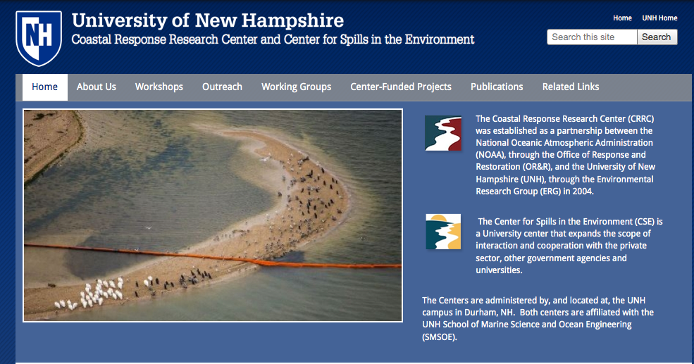
Coastal Response Research Center
(CRCC)
Center for Spills in the Environment
(CSE)

Slide 3
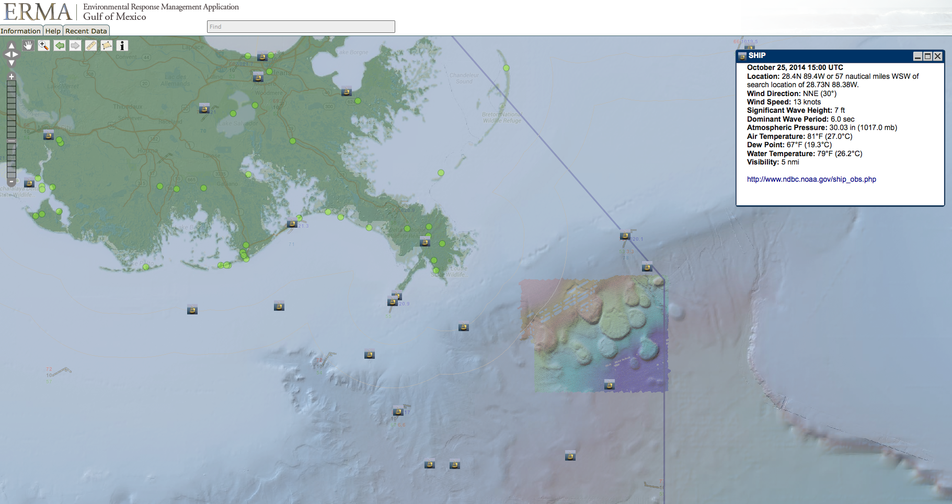
ERMA – Environmental Response Management Application

Slide 4
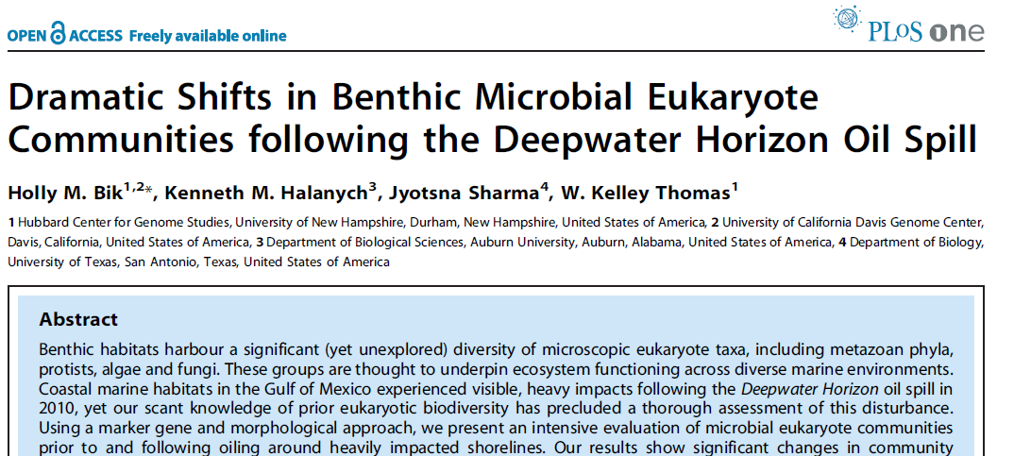
Metagenomic approach to understanding impact of spill on benthic communities

Slide 5
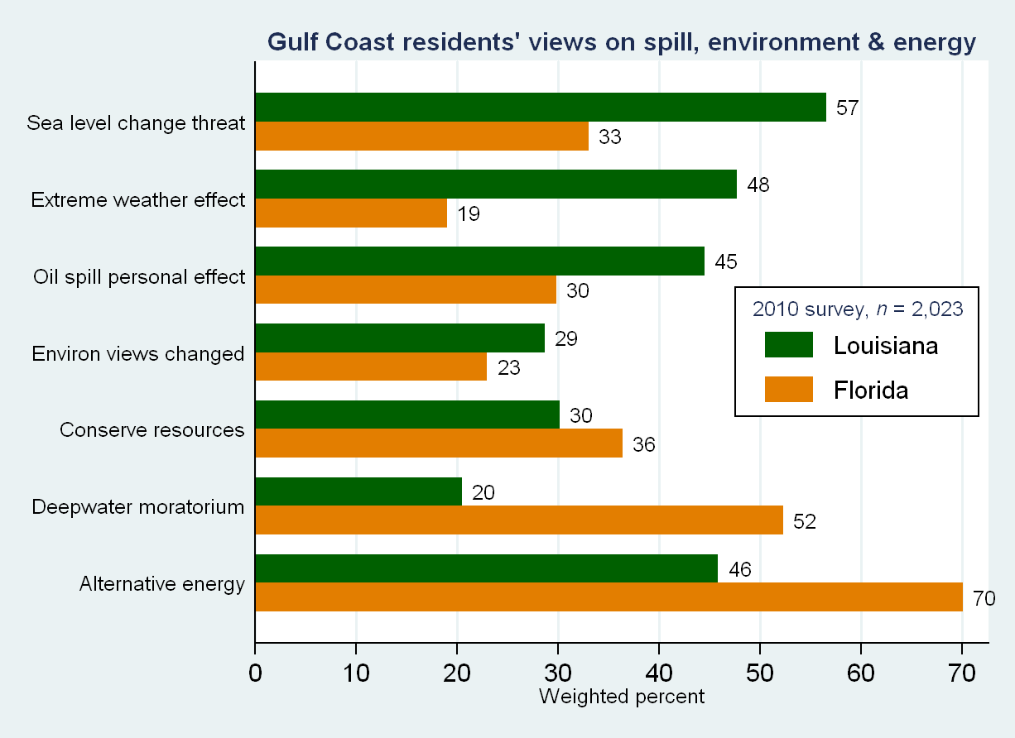
Louisiana residents perceive more serious threats from the spill, extreme weather and sea level rise. However, Louisiana residents were less likely to support mitigation —conservation, deepwater drillling moratorium or alternative energy development.
CARSEY INSTITUTE
During spill -- interviewed 2,000 residents in Gulf Coast Louisiana and Florida
A striking contrast emerged:
Hamilton, L.C., T.G. Safford and J.D. Ulrich (2012). “In the wake of the spill: Environmental views along the Gulf Coast.” Social Science Quarterly 93(4):1053–1064.

Slide 6
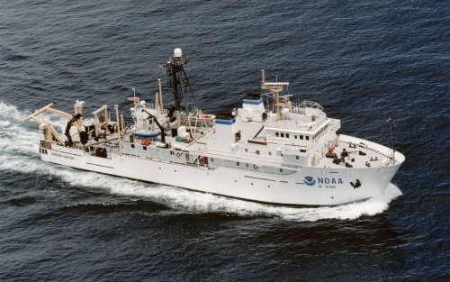
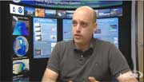
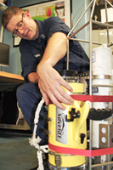
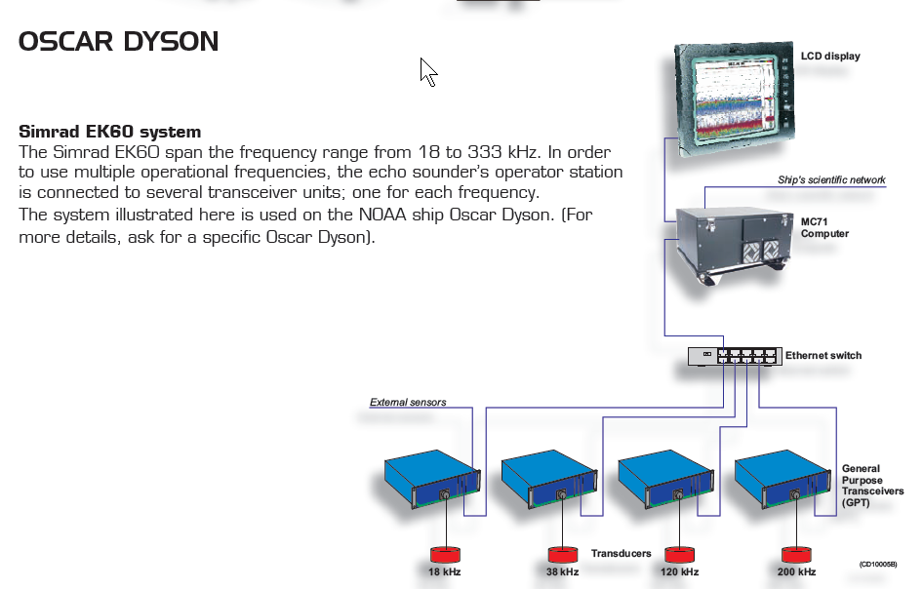
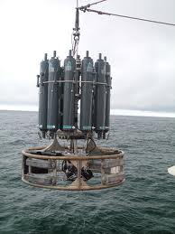
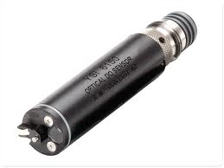
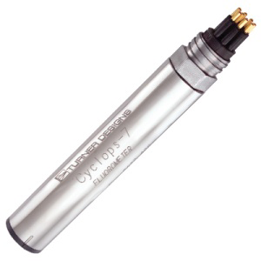
Gordon Gunter
Simrad EK60 sounders
18, 38. 120 and 200 kHz
“split beam”
Dissolved Oxygen
CDOM Fluorometer

Slide 7
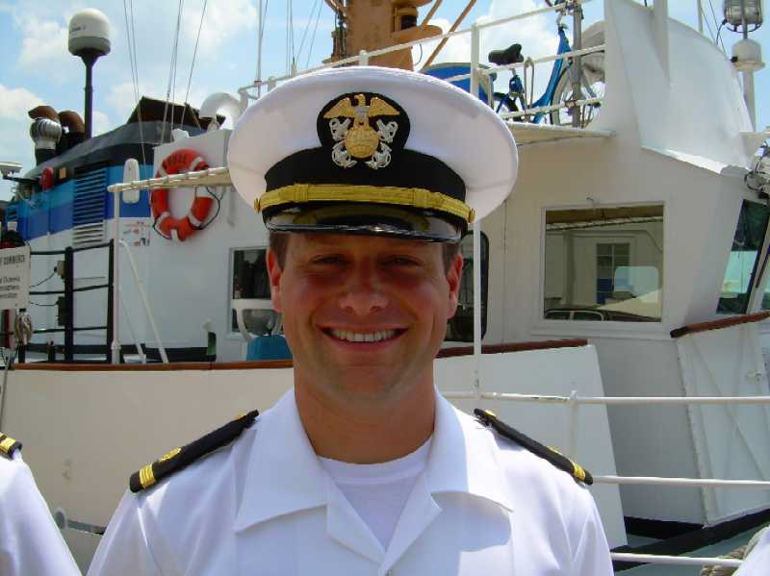
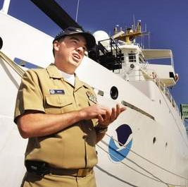
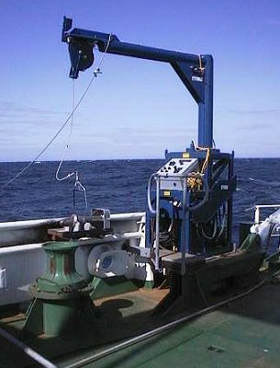
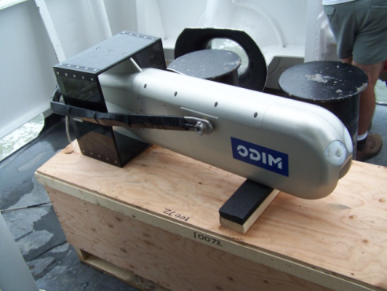
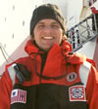
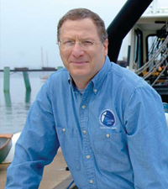
Thomas Jefferson
Simrad EK60 sounders
18, 38. 120 and 200 kHz
“split beam”
Dissolved Oxygen
CDOM Fluorometer

Slide 8
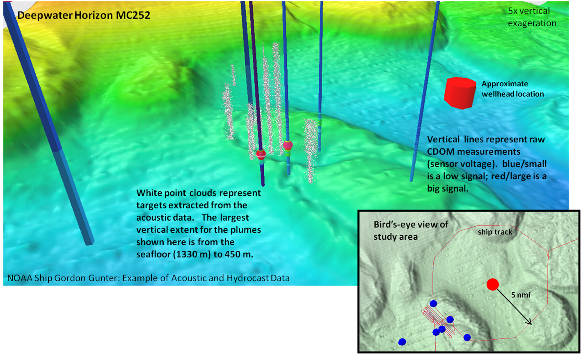
Data Synthesis and Visualization

Slide 9
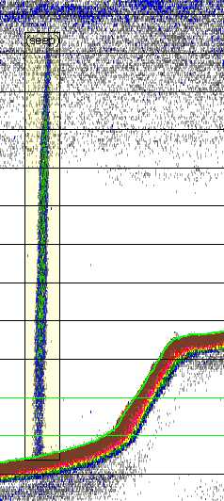
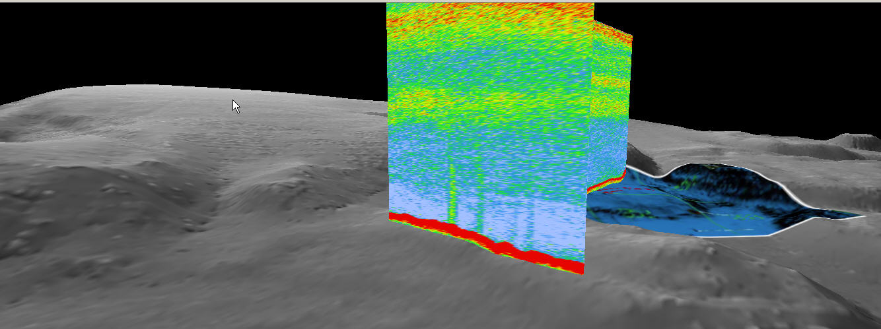
NATURAL SEEPS
OIL RISING NEAR WELL-HEAD

Slide 10
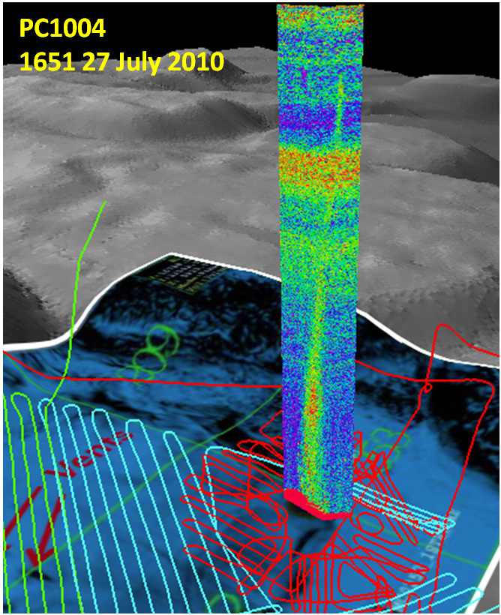
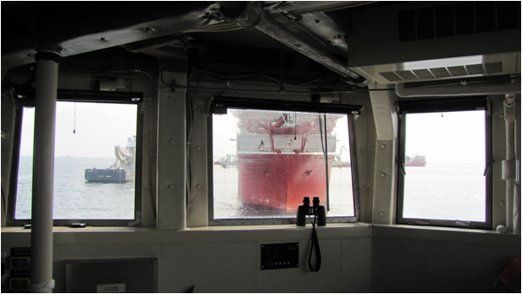
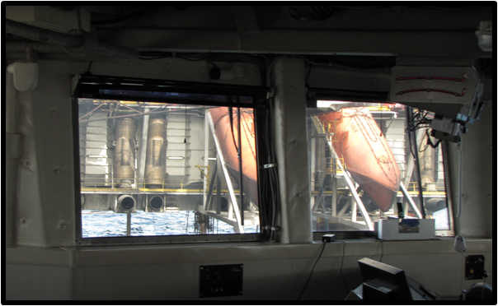
Wellhead Integrity:
Post-Cap
Acoustic Monitoring

Slide 12
PC1003
18 July 2010 Wellhead survey

Slide 13
PC1003
18 July 2010 Wellhead survey

Slide 14
PC1003
18 July 2010 Wellhead survey

Slide 15
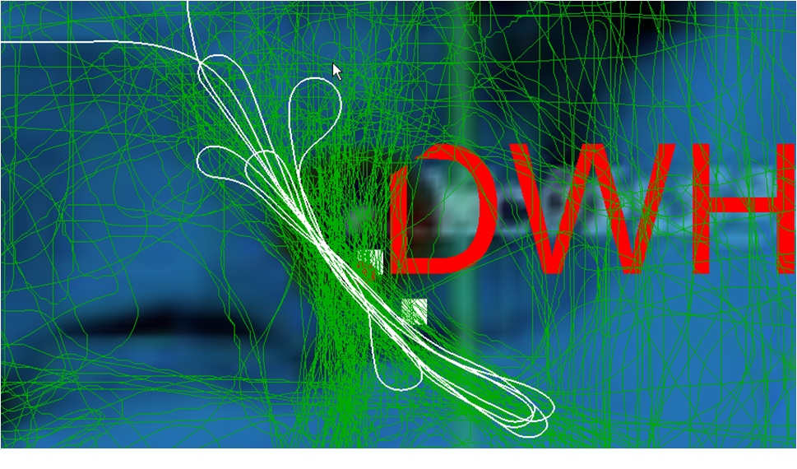
16 July → mid October

Slide 16
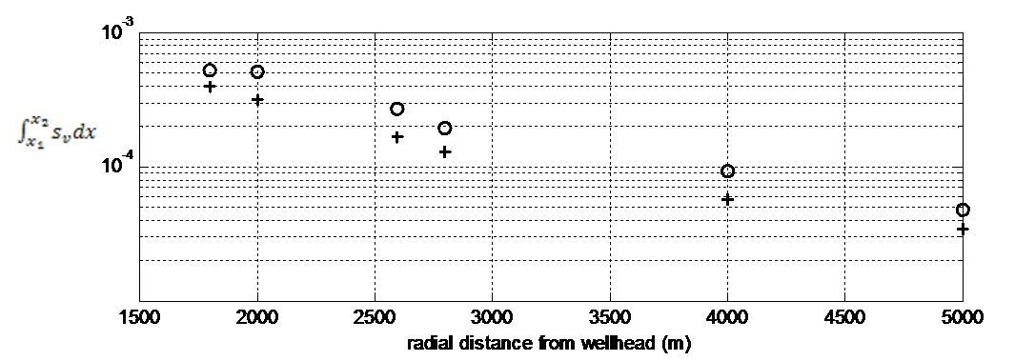
USING ACOUSTICS TO MEASURE FLUX
Seawater |  |  |  |  | Oil
T (⁰C) | S (PSU) | ρ (kg/m³) | c (m/s) | µ (Pa s) | T (⁰C) | ρ (kg/m³) | c (m/s)
15 | 35.9 | 1027.6 | 1511.4 | 0.0012 | 15 | 839 kg/m³ | 1440.6

Slide 17
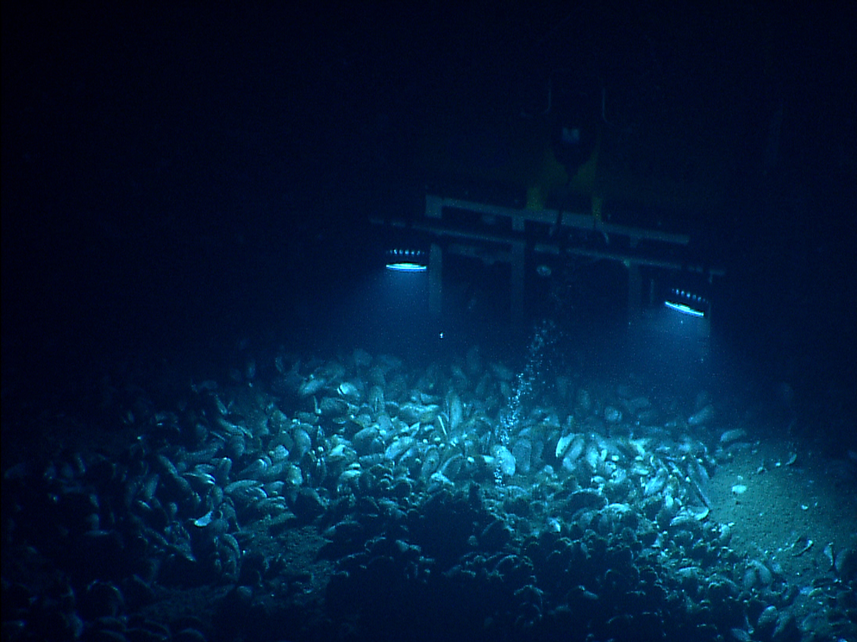
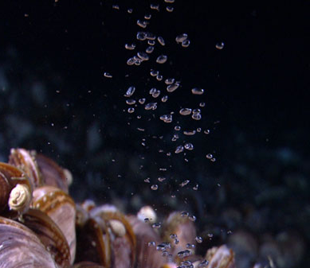
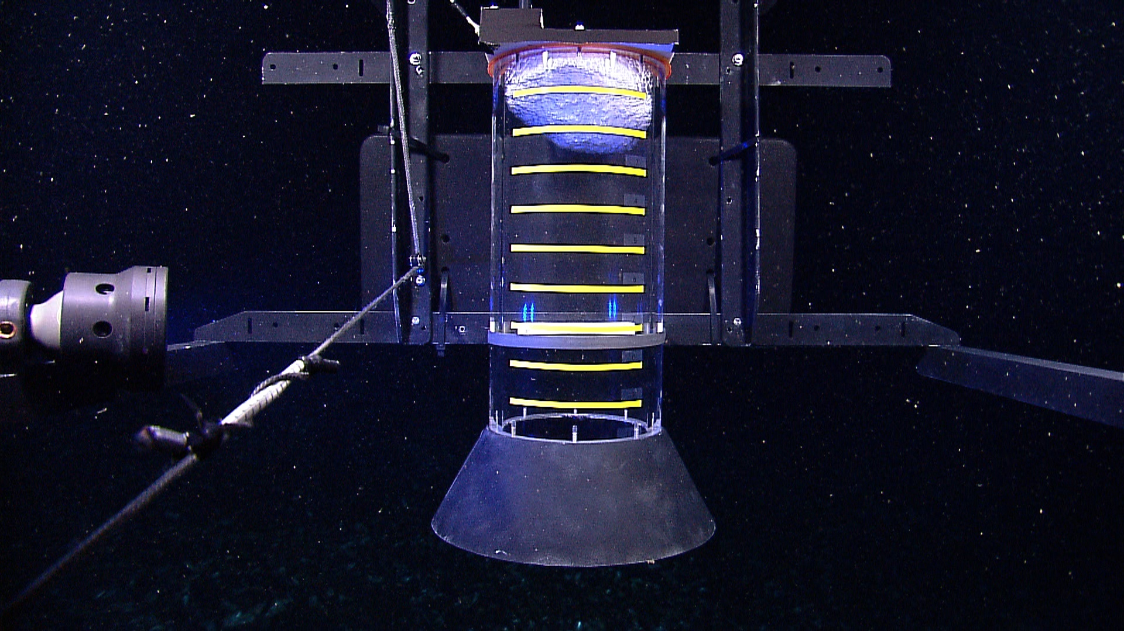
Ground-truthing gas flux

Slide 18
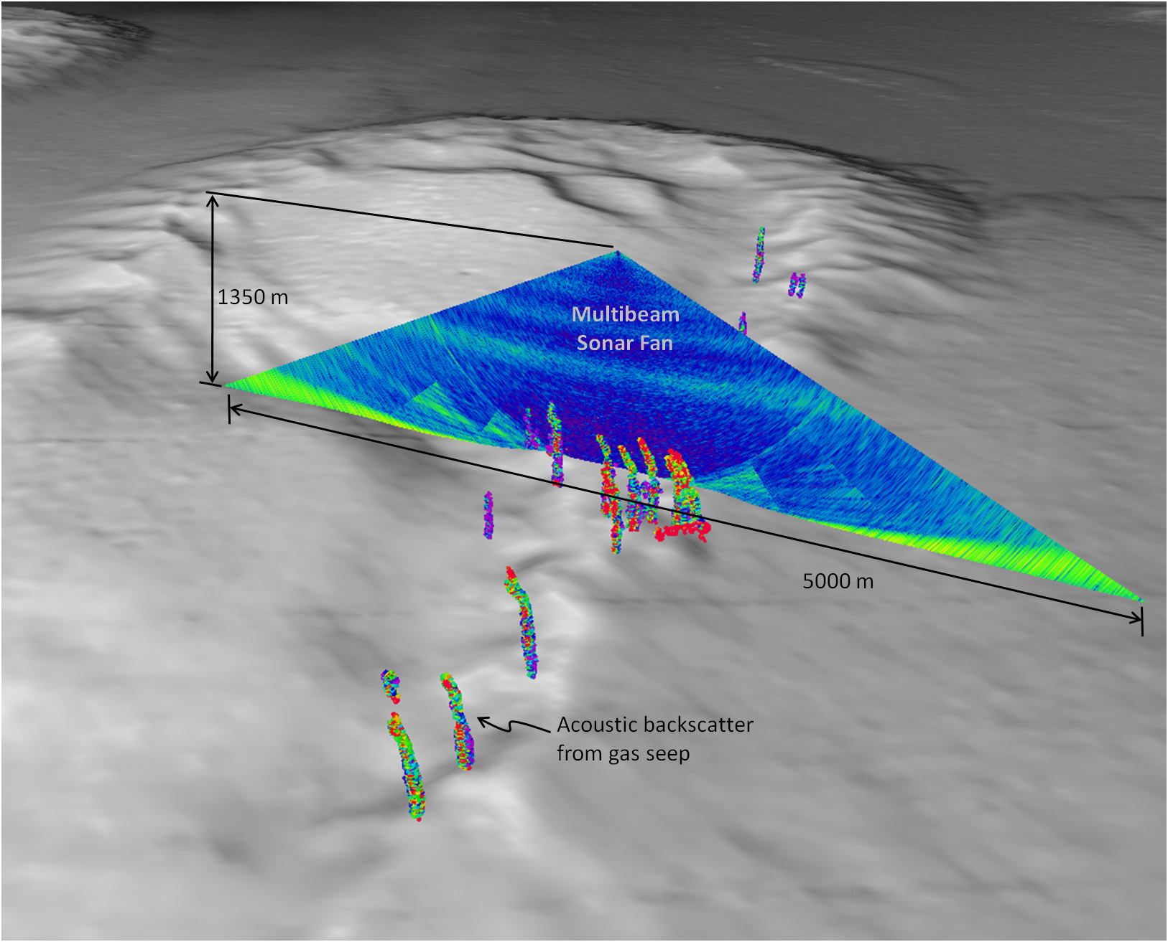
OKEANOS EXPLORER EM302 SEPT 2011

Slide 19
