Slide 1
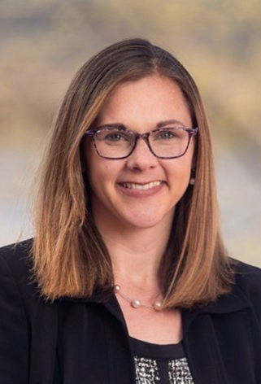
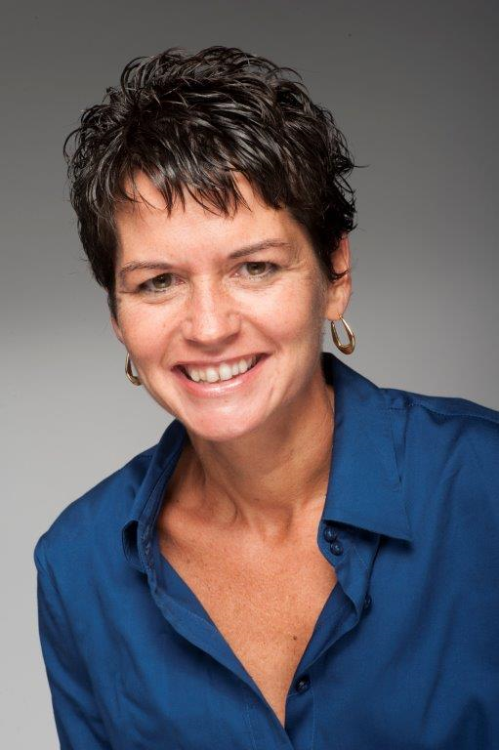
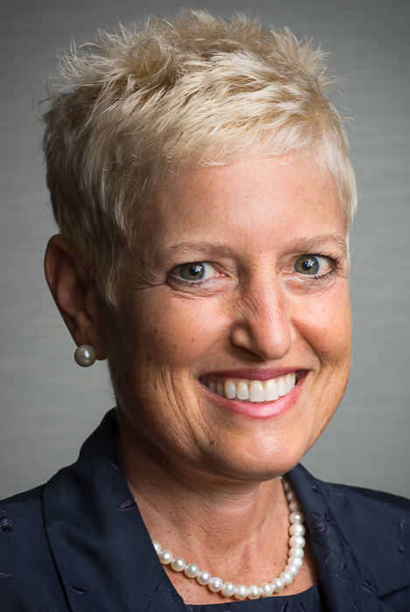
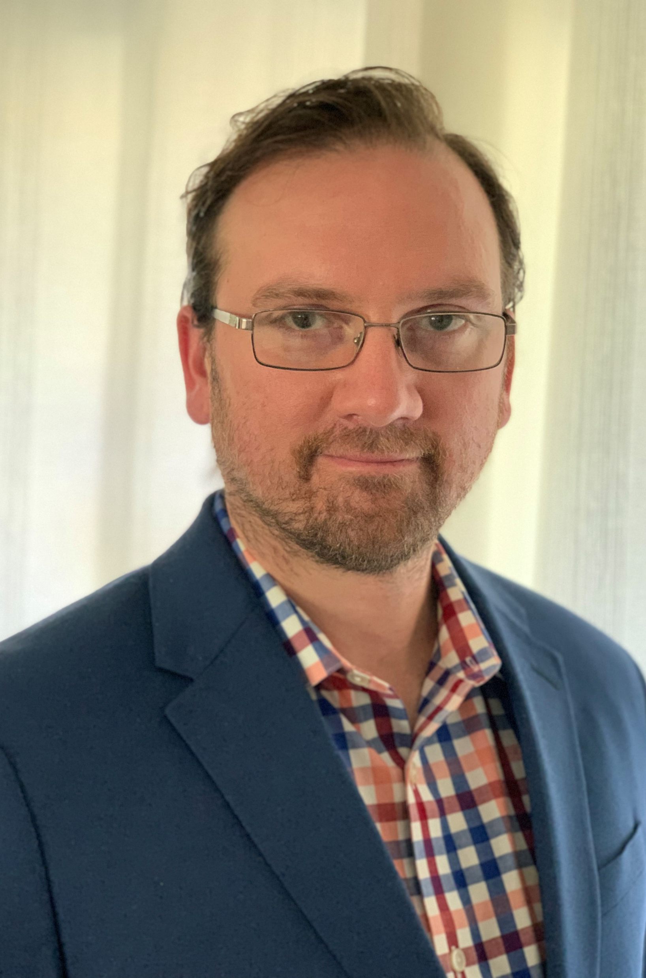
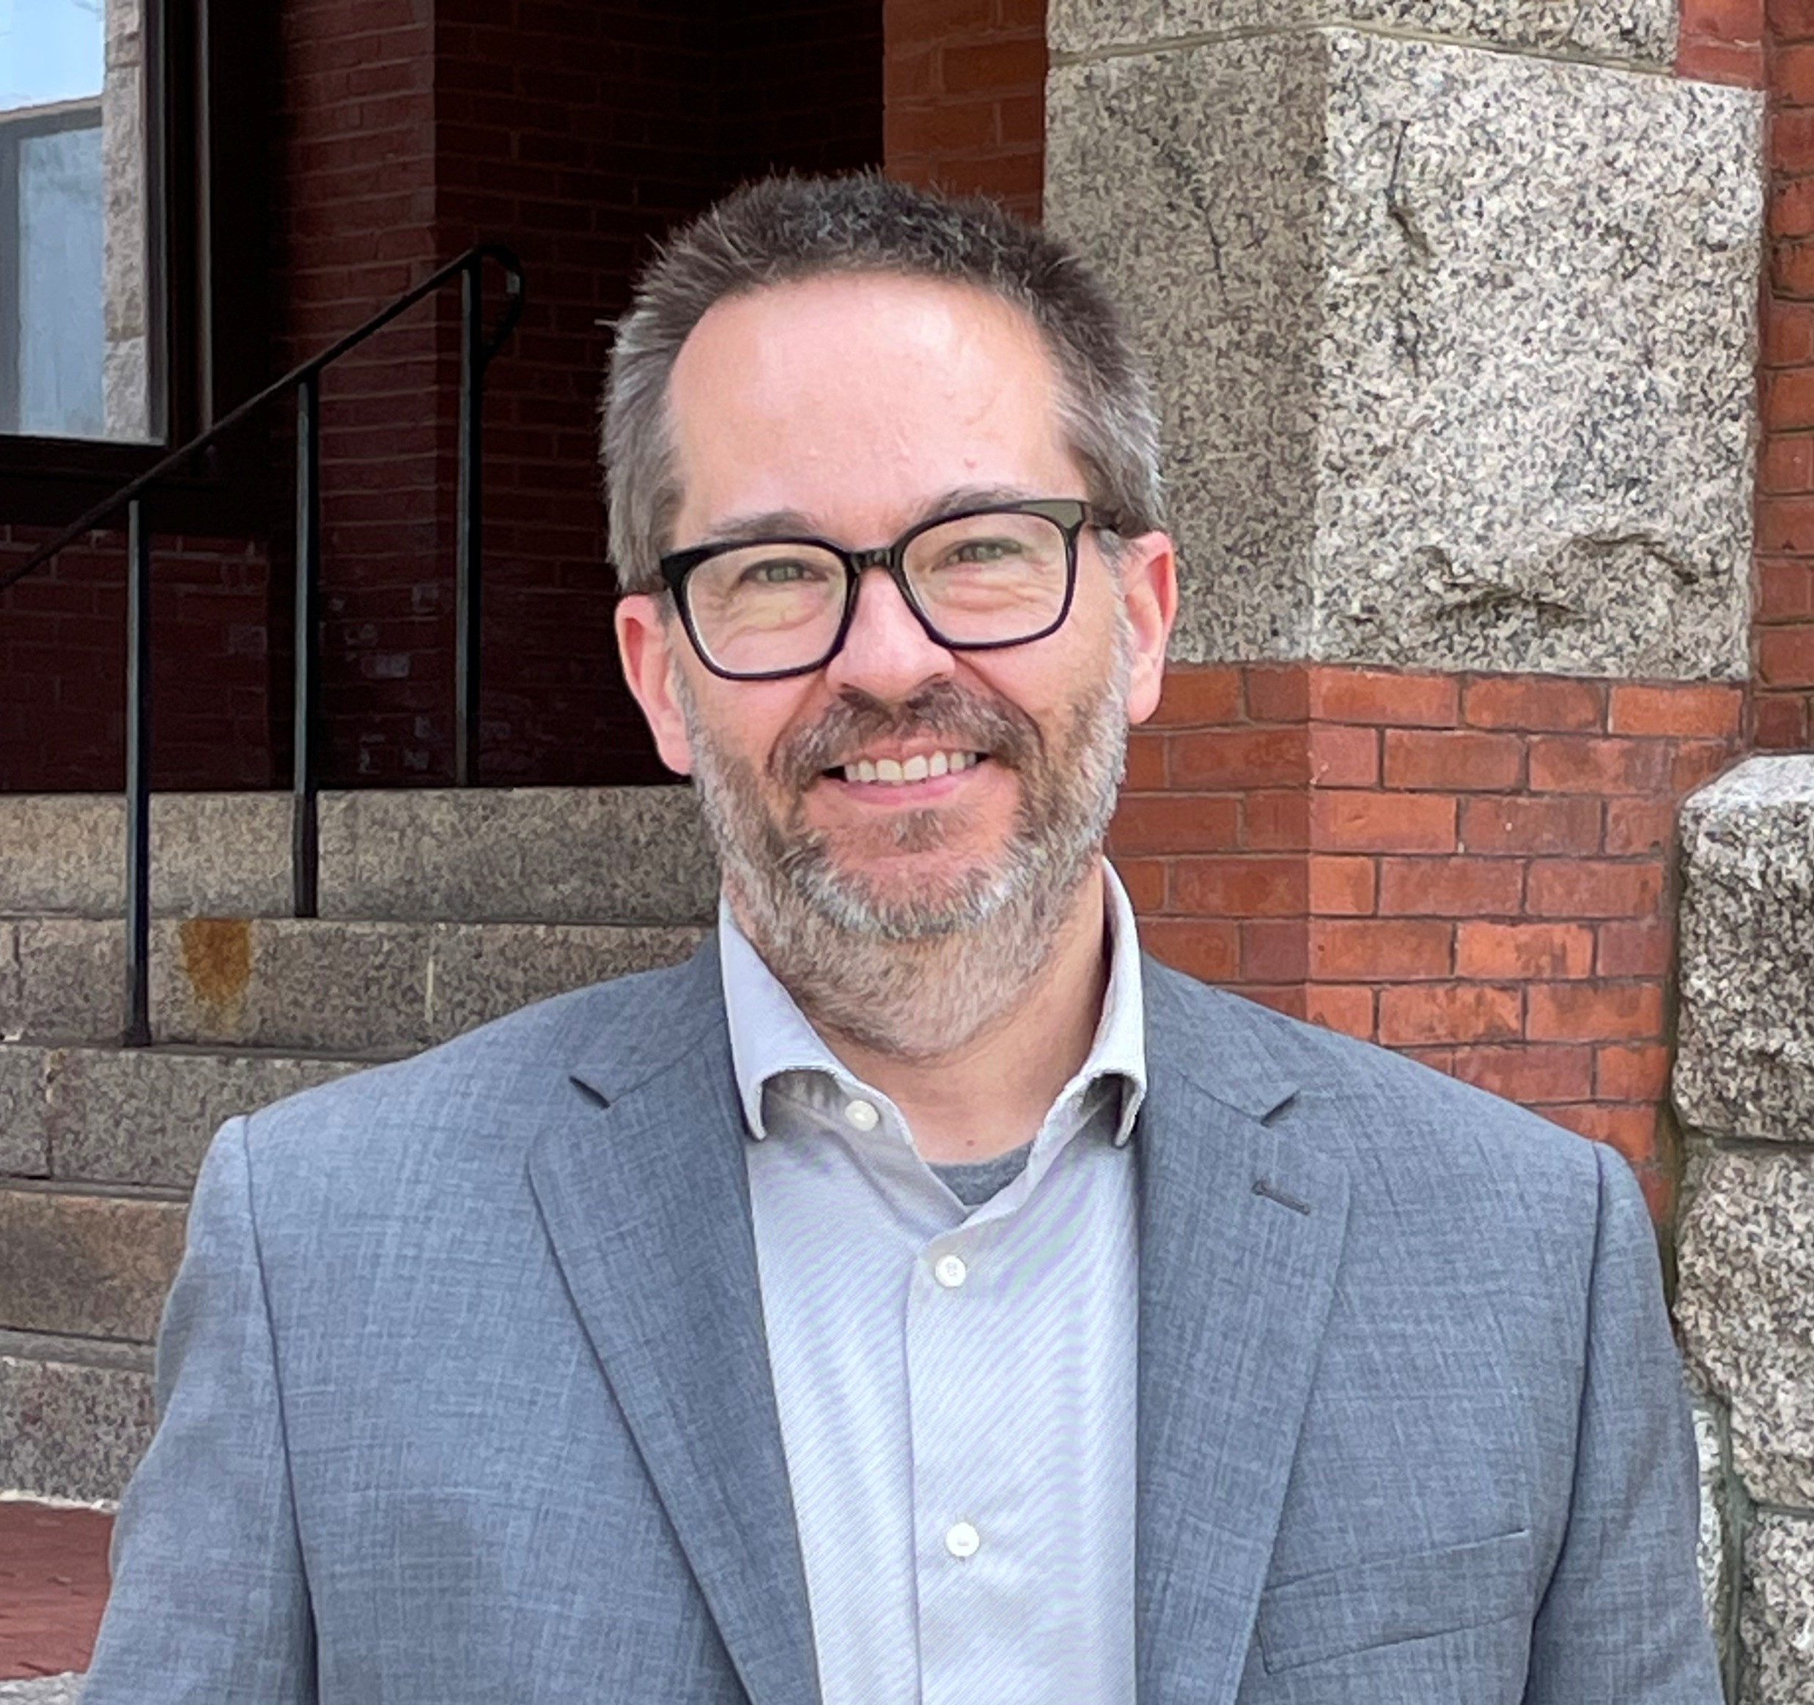
Provost’s Senior Staff
Kimberly DEREGO
Vice provost for enrollment MANAGEMENT
Peg kirkpatrick
Director, Academic AFfairs
Marian G. MCCORD
SR. VICE PROVOST FOR RESEARCH, ECONOMIC ENGAGEMENT AND OUTREACH
John Wallin
Assistant provost, contract administration
Matt macmanes
Interim vice provost for ACademic affairs

Slide 2
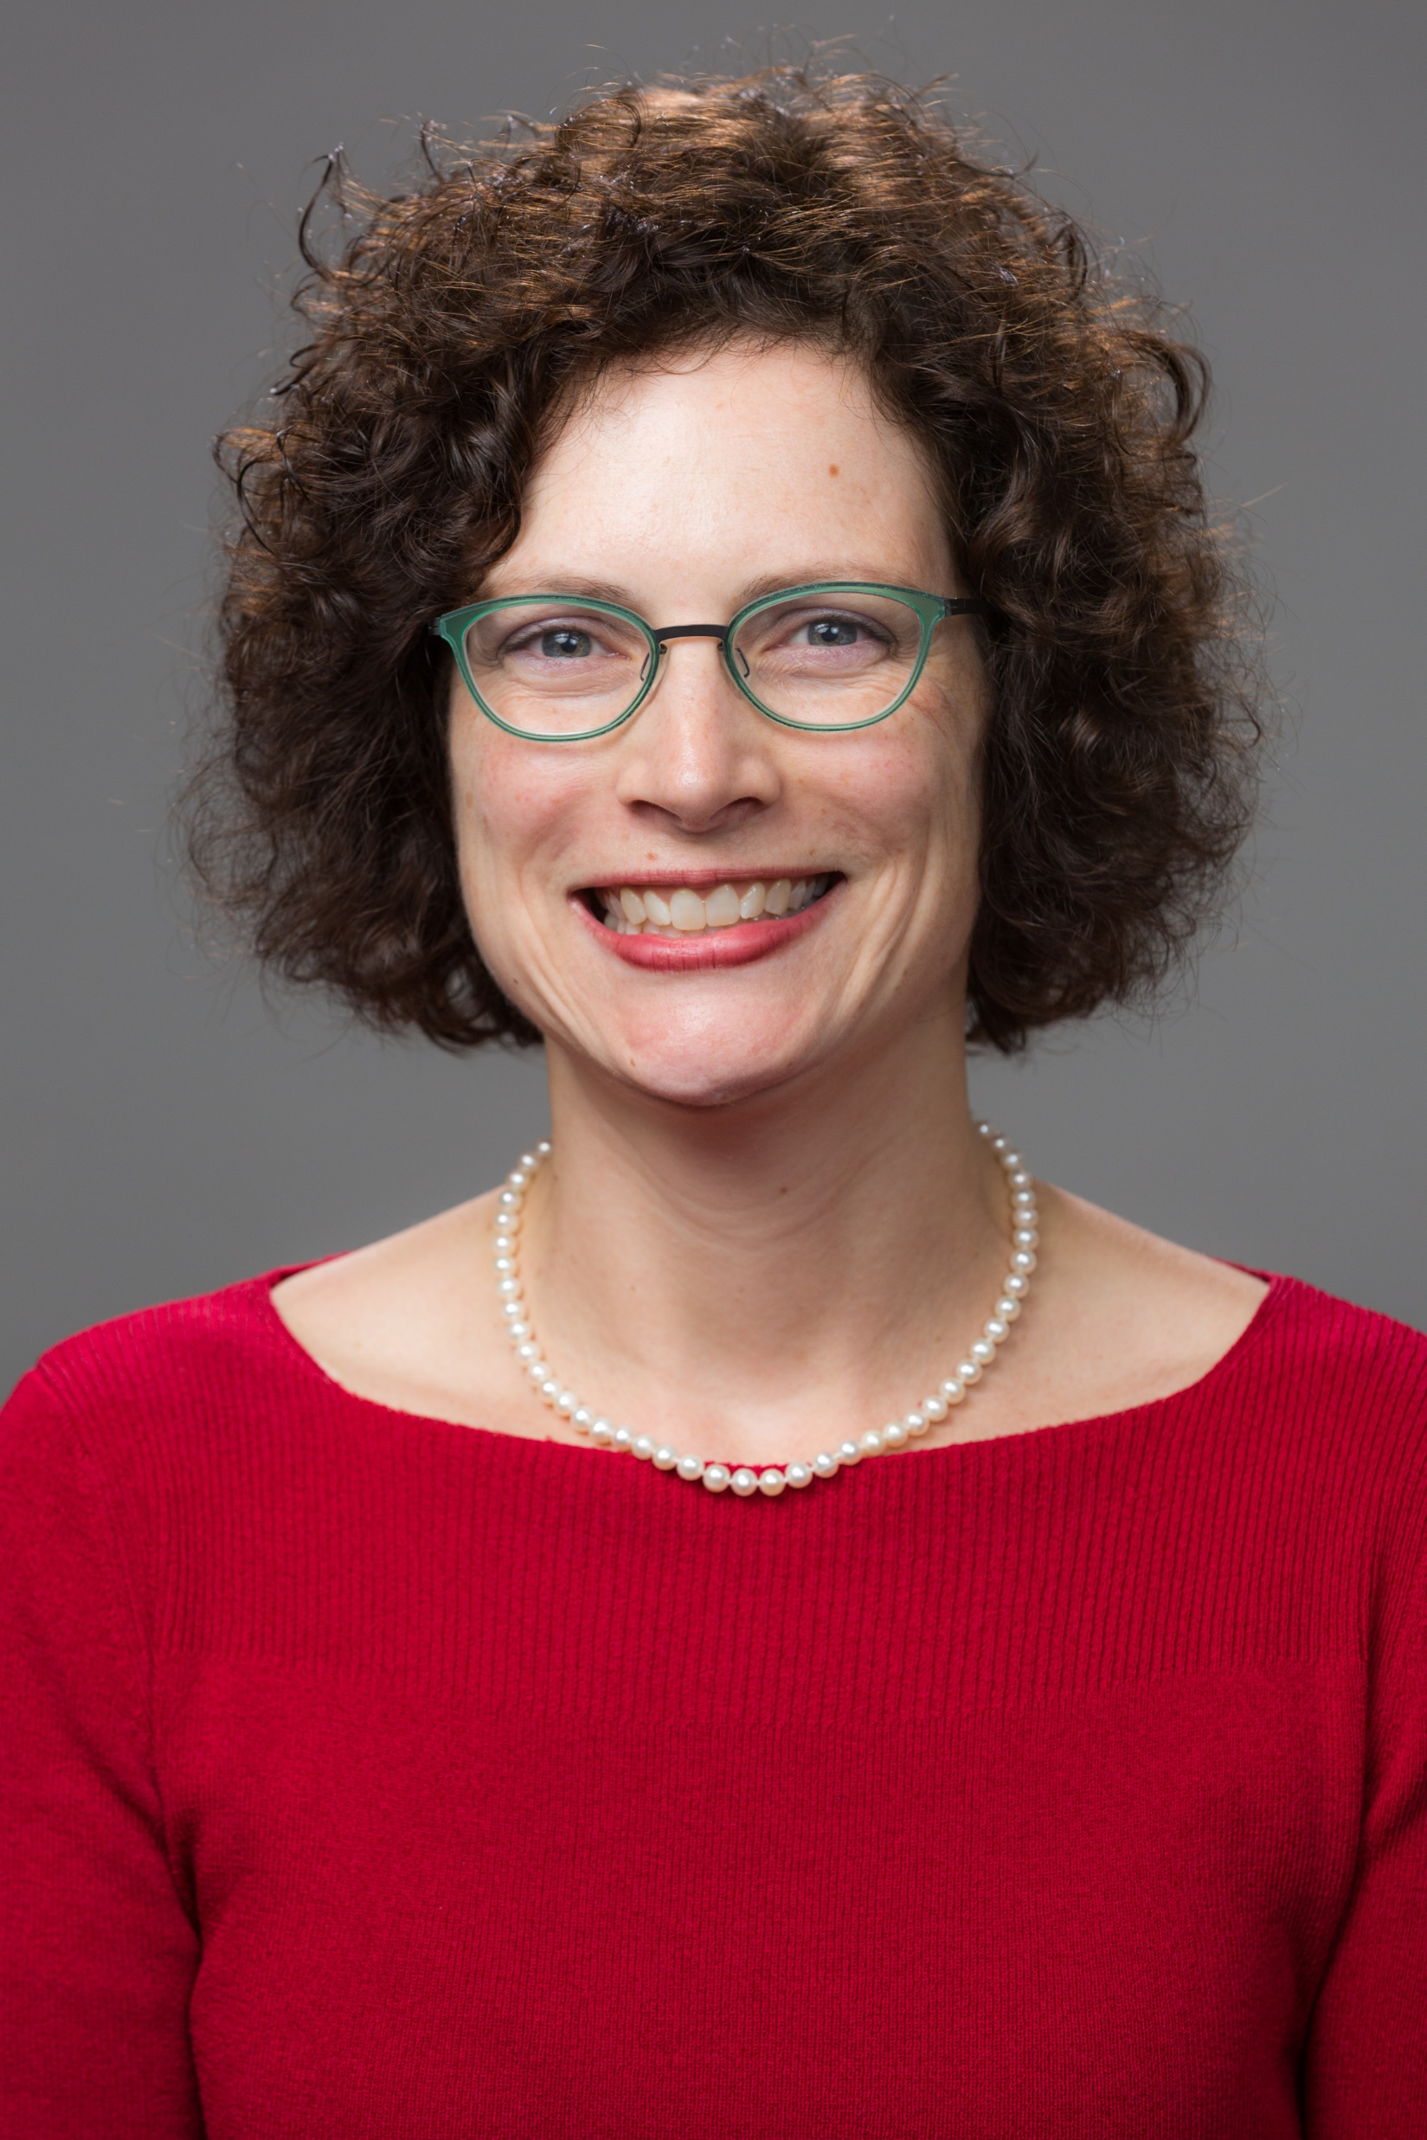
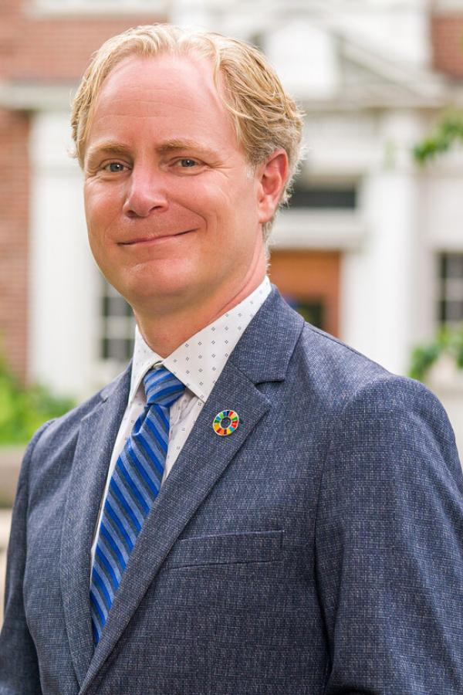
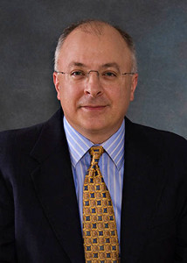
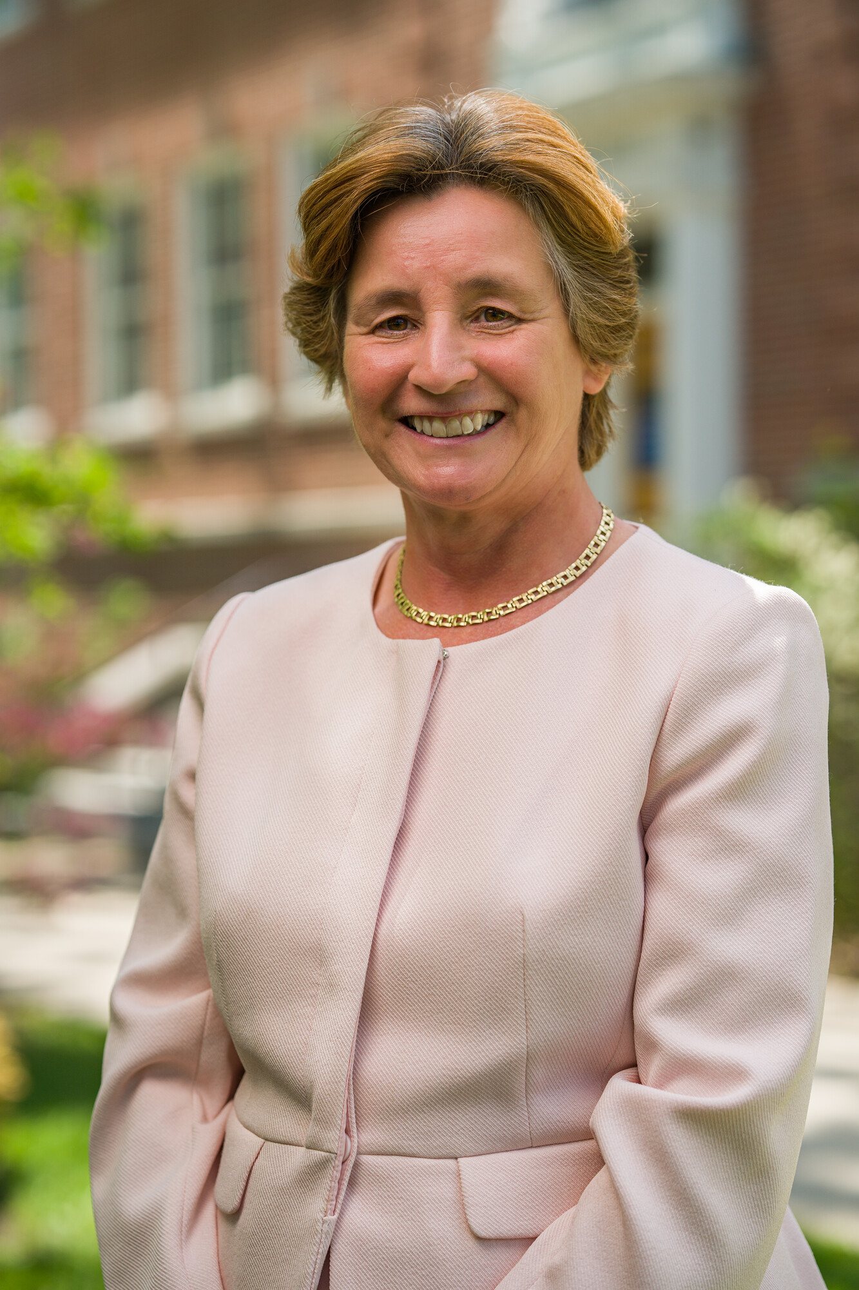
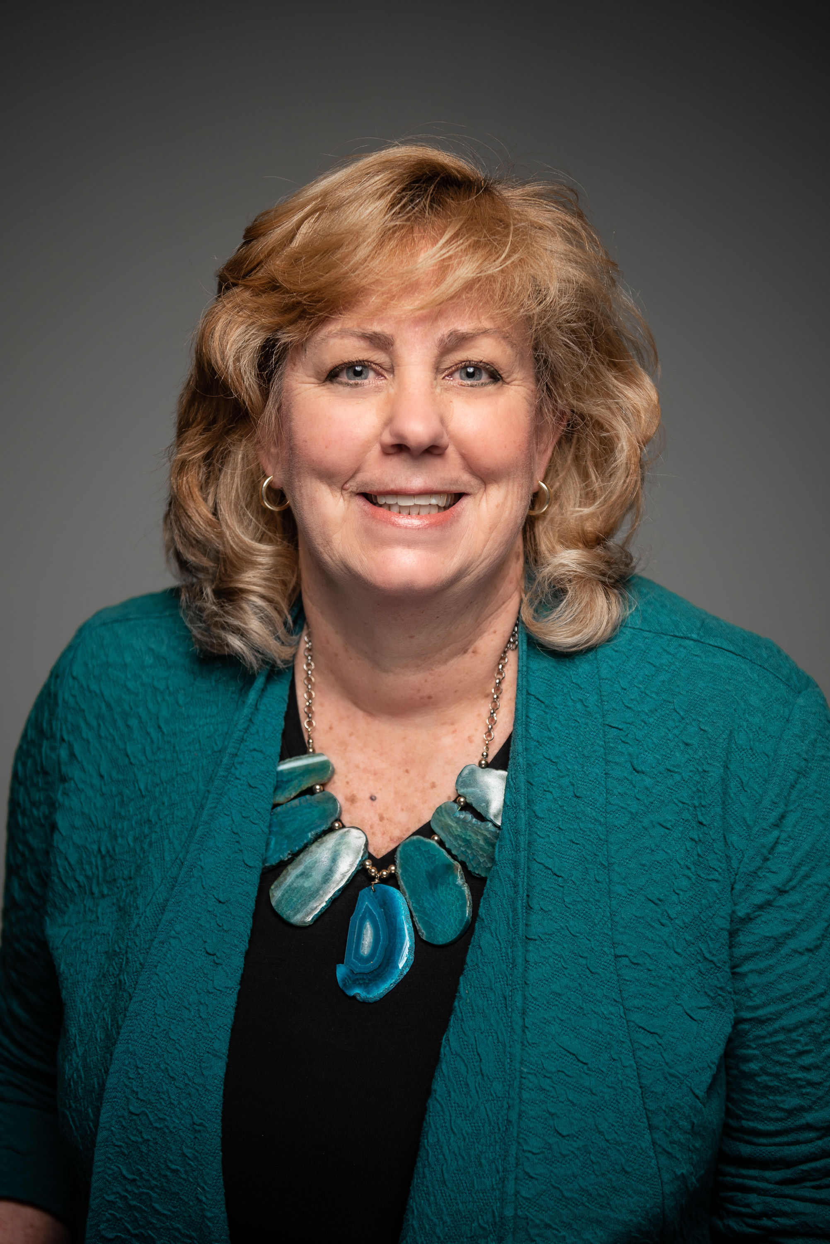
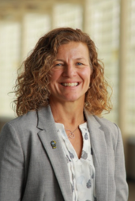
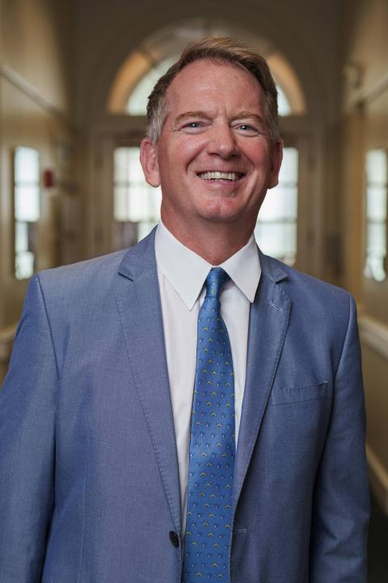
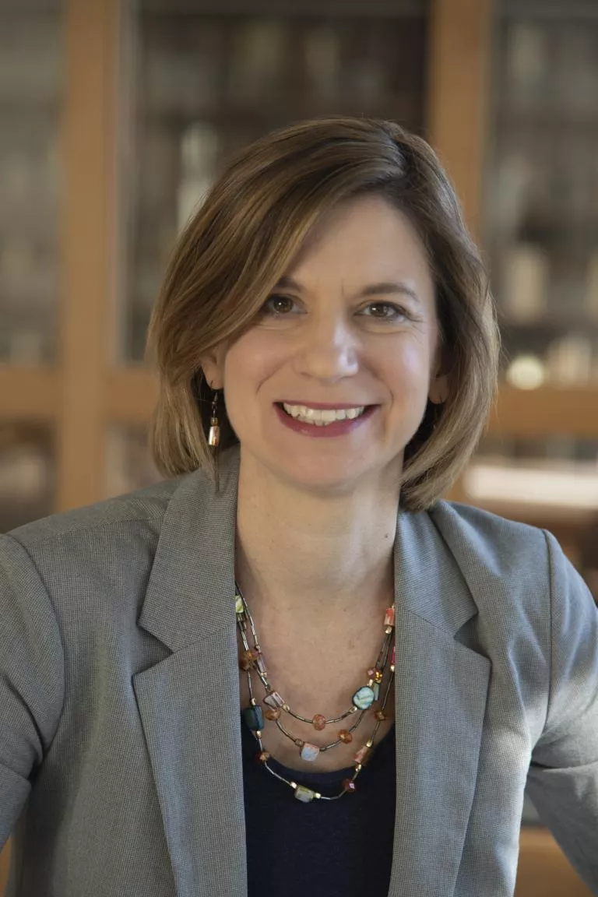
UNH Deans
MEGAN Carpenter
DEAN, UNH
Franklin pierce school of law
Kirsten corazzini
DEAN, UNH
College of health and human services
Anthony Davis
DEAN, UNH
College of life sciences and agriculture
Michael Decelle
DEAN, UNH
College of Professional studies
Michele Dillon
DEAN, UNH
College of liberal arts
LUCY gilson
DEAN, UNH
Paul college of business and economics
Cyndee Gruden
DEAN, UNH
College of engineering and physical sciences
Ashby kinch
Vice provost and dean, UNH
Graduate school
Kimberly Sweetman
DEAN, UNH
University library

Slide 3
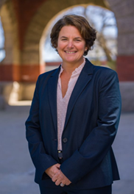
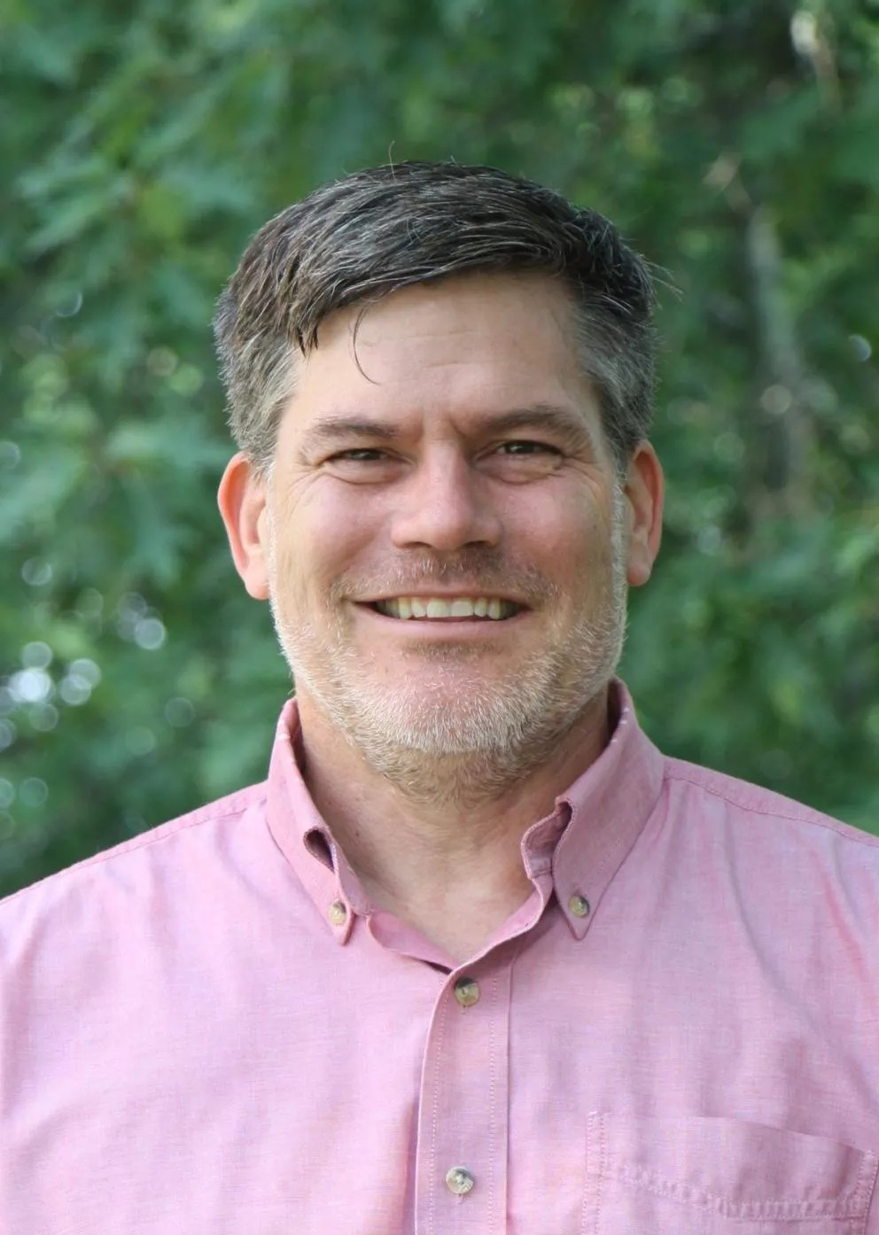
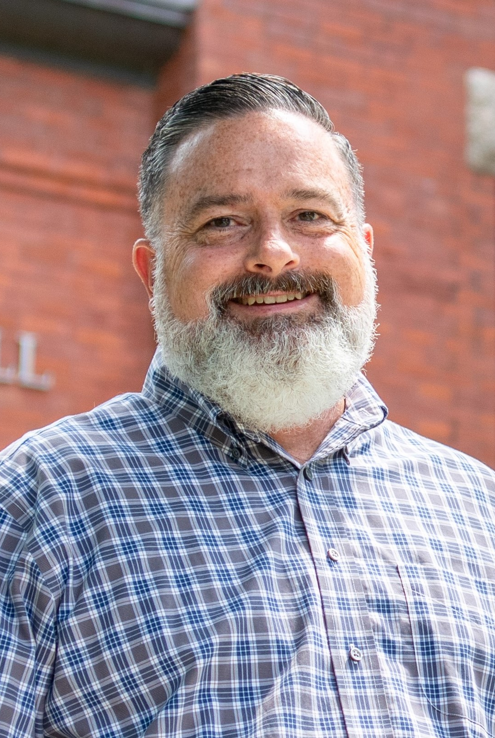
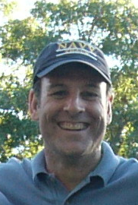
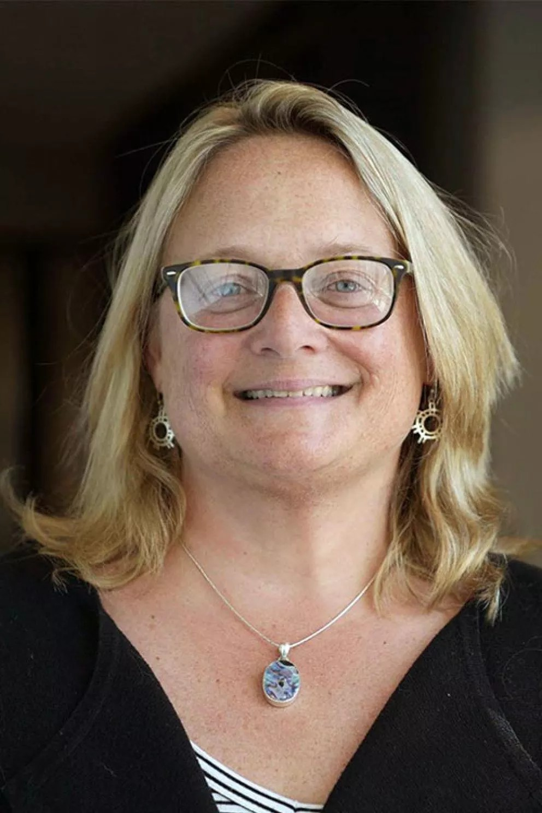
School, Institute, and Senior Leaders
Sarah littlefield connor
Director of finance for academic units
Erik Chapman
Interim director, School of Marine Science & Ocean Engineering
Kenneth j. la valley
Vice provost and learning officer
David e. Matta
Director of finance for academic affairs
Ruth varner
Interim Director, institute for the study of earth, oceans, and space

