Slide 1
DESIGN-BUILD-TEST CYCLE
THE PROTOTYPE
A program of the
Notes:
Welcome to our seventh session for our invention unit with the Young Inventors’ Program.
Today we are going to cover YIP Lesson Seven: The Design-Test-Build Cycle

Slide 2
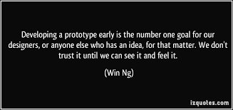
Learning Goal: I will design, build, test and retest a prototype of my invention idea. I will evaluate and modify my model as I develop my invention.

Slide 3
MATERIALS:
Pencil or pen
Notebook paper or other paper for writing and drawing
YIP Inventor’s Journal
Build materials (such as, but not limited to: recycled materials, tape, glue, scissors, clips, string, fabric, markers…)
Optional: Wisk or other kitchen utensil

Slide 4
STEPS OF THE INVENTION PROCESS
Identify
Understand
Ideate
Design
Build
Test
Redesign
Communicate

Slide 5
DESIGN
Let’s revisit the Invention Process
Draw the design and label the parts and movements.
Test the prototype to collect feedback and data.

Slide 6
Guided discovery
You will have time to build and test your prototype. Use the following steps to plan your project.
BUILD
TEST
REDESIGN

Slide 7
Let’s talk
How might you plan your steps?
How might you test your prototype once you build it?
How will you know to try something different or that you need to make modifications?
How will you be able to know what modifications you might want to make?
Why is testing important to the Invention Process?

Slide 8
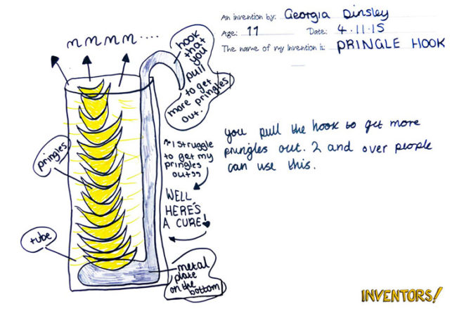
IF YOU HAVE NOT ALREADY…
Draw a model of your invention design.
Label all parts. Make note of the materials you need, parts that may move, and special features.
Add your drawing to your YIP Inventors Journal.

Slide 9
TIME TO BUILD
Now that you have your drawing, begin building your invention!
STEP 1. Build your prototype based on your drawing. Tinker with materials and how they fit together.
Take photos to show your work and add them to your YIP Inventor Journal.

Slide 10
STEP 2. Test your prototype. Does it work? What changes do you need? Record your data in your YIP Inventor Journal.
If you change anything while building and testing, make sure to draw that change in your design and explain the need for the change in your journal.

Slide 11
ACTIVITY:
SCAMPERING AGAIN

Slide 12
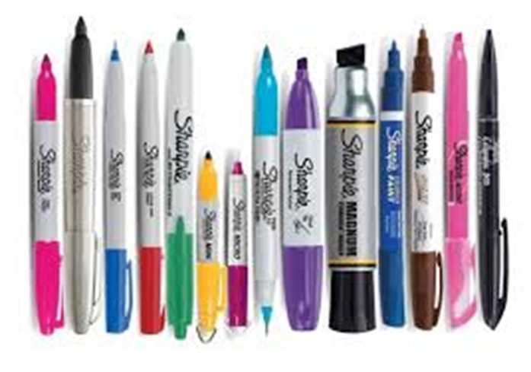
SCAMPER
How to brainstorm and think creatively.
Substitute with something else
Combine with another object or idea
Adapt for new uses
Modify or change
Put to other use
Eliminate parts of the object or idea
Rearrange or reverse the object or idea

Slide 13
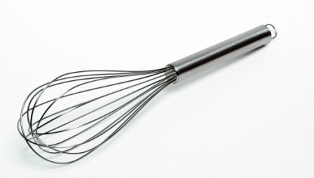
CHALLENGE:
Brainstorm new ideas for a whisk using the SCAMPER method.

Slide 14
INSTRUCTIONS:
Go through each letter of SCAMPER and think of new uses or ways to make your whisk.
If you need help, use the SCAMPER On Your Own Worksheet.

Slide 15
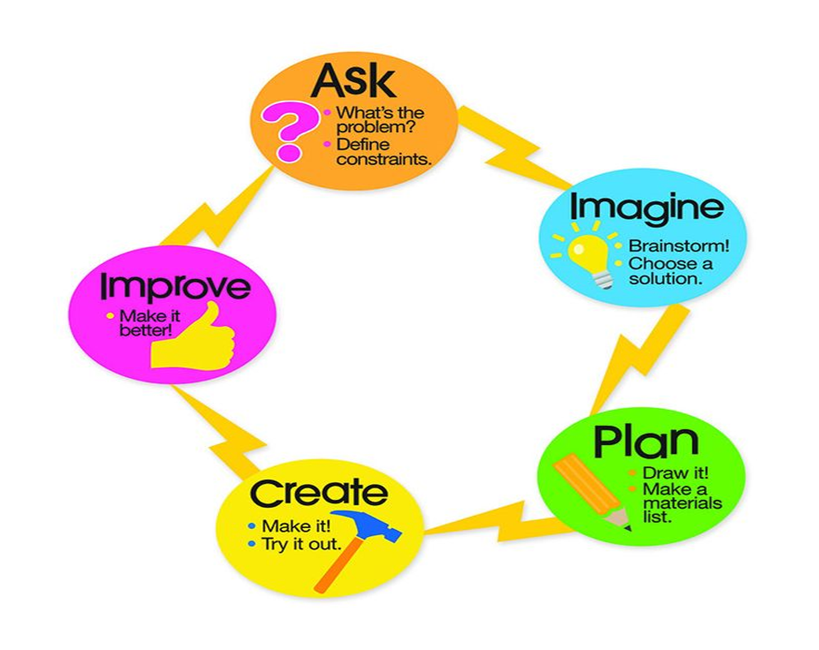
THINK ABOUT:
As you build and test, think about these steps.
These are the steps of the Invention Process.
What is working? What is not?
How do you know when something works?
What will you do when something does not work?
How will your YIP Inventor’s Journal help you?

Slide 16
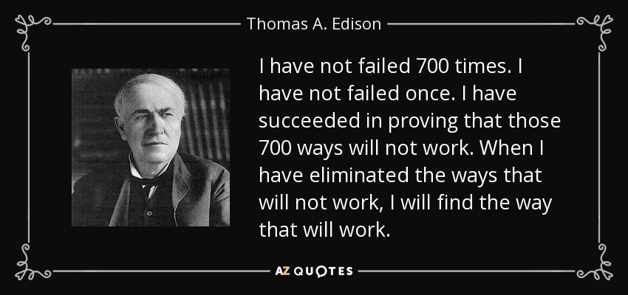
Today I learned…
To test and modify a design based on observations and data to solve a problem.
I also learned to document and explain my process by recording in my invention journal.

