Slide 1
The New Digital SAT 2024

Slide 2
Agenda
What’s new?
Test Structure
Content
Scoring
Test Taking Strategies
Navigating Bluebook
Reading and Writing Test
Math Test

Slide 3
What is new on the new Digital SAT?
Absolutely Nothing!
Almost
College Board has decided to repackage old question types
Sentence Completions
Writing Questions
Vocabulary Questions
Everything Math
Experimental Questions

Slide 4
Timing
The Digital SAT is 2 hours and 14 minutes long.
Reading and Writing (2 modules, each 27 questions in 32 minutes)
  All questions in the RW section are multiple-choice.
  Two questions in each module are experimental and are not scored.
  All questions on the exam are multiple-choice with four possible answers
A 10-minute break
Math (2 modules, each 22 questions in 35 minutes)
  Most questions in the Math section are multiple-choice.
  The rest are “student-produced responses” (fill-ins).
  Two questions in each module are experimental and are not scored.
  The Math section contains some student-produced-response questions.
  All multiple-choice questions have four possible answer choices.

Slide 5
Old vs New
Old
Reading and Writing Section Separate
several questions attached to each long passage
65 minute reading 52 questions 35 minute writing 44 questions Optional Essay
25 minute no calculator math 20 questions (5GI) 55 minute calculator math 38 questions (8GI)
Section subscores given
New
Reading and Writing Section Together
Each short passage (which College Board calls a “text”) or pair of passages (texts) is associated with just one question, and texts may be paired with informational graphics.
64 minutes long, 2 modules, each with 27 questions that are passage-based. No Essay
Third and fourth parts of each module, there will be questions focused on writing skills. Instead of asking you to analyze a text, questions will require you to do things like choose answers with correct punctuation and grammar.
70 minute long, all with calculator, 2 modules, each with 22 questions, approximately 11 questions are Fill-Ins
Only total, RW section, and M section scores given

Slide 6
Content
New Math Digital SAT Content
The Math section covers four main content areas, but not in this order:
Algebra (≈35%)
Advanced Math (≈35%)
Problem-Solving and Data Analysis (≈15%)
Geometry and Trigonometry (≈15%)
New Reading and Writing
The RW section consists of four parts in order:
Craft and Structure (≈28%)
Information and Ideas (≈26%)
Standard English Conventions (≈26%)
Expression of Ideas (≈20%)
The questions in each content area will be arranged by type and, in most cases, in order of difficulty.

Slide 7
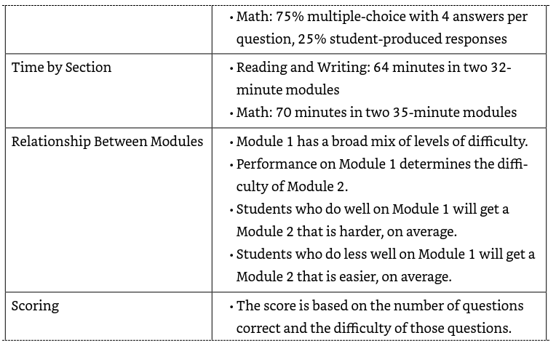
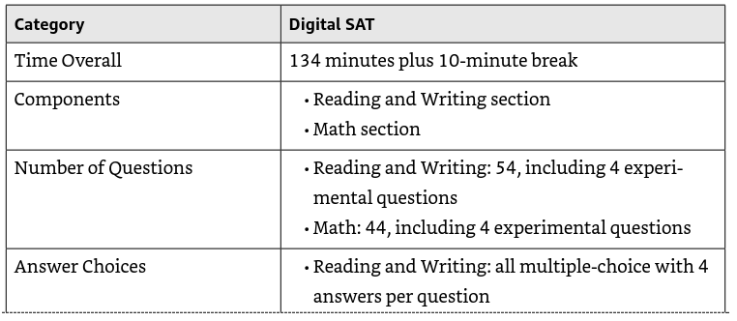
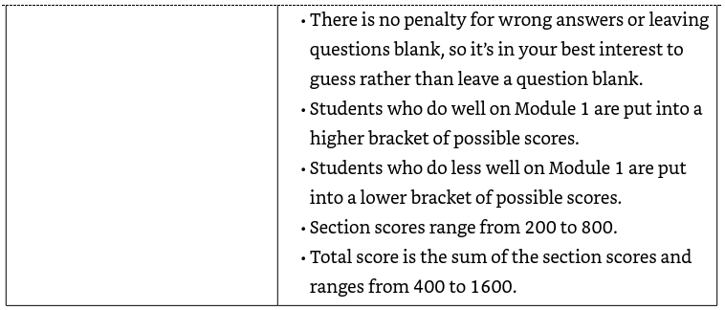
Test Summary

Slide 8
Scoring
Scores from the Digital SAT will be reported in a matter of days, not weeks as was the case with the paper-and-pencil test. Your score report for the Digital SAT will feature:
Total Score: The sum of the two section scores (Reading and Writing, Math), ranging from 400 to 1600
Section Scores:
  Reading and Writing, ranging from 200 to 800
  Math, also ranging from 200 to 800

Slide 9
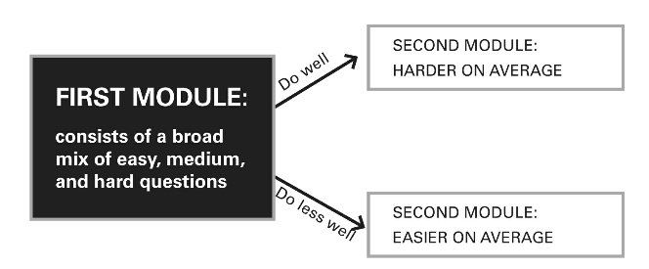
Active Scoring

Slide 10
Something New
Some questions within a module are also weighted
Doing better on those will increase your score more than doing well on easier, non-weighted questions.
Score is determined not only by how many questions you got right but also by how hard those questions were.

Slide 11
New Test Taking Strategies
TAKE THE EASY TEST FIRST
  Within a section, each question counts toward your score.
  you can answer questions in any order you like.
  To maximize your score, leave the questions you don’t like for last is called taking the easy test first.
  Skip early and skip often, resulting in two passes through an individual module.
Embrace Your POOD
Mark and Move On
  If you think a question is worth coming back, use the Mark for Review tool to add a little flag next to the question.
  Keep on moving until you find a question that better suits your POOD.
  A troublesome question don’t keep working on it. Mark it and move on to do more questions.
  Once you’ve conquered all the questions in your POOD come back and retry a question.
  Find another question in the module to distract your brain whenever you get stuck.
  You can see the marked questions at a glance both at the end of the module and by opening the module overview at any time.
  Clicking the black bar at the bottom of the screen opens the Review tool, which gives you an overview of the module that will look something like this.

Slide 12
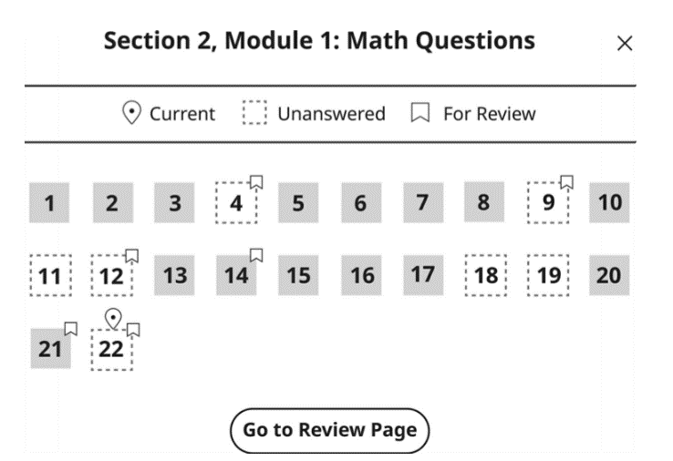
Navigating Bluebook

Slide 13
New Test Taking Strategies
In your first pass, only do questions that you think you can do quickly and accurately.
If you start a question and get stuck, mark it and move on.
If you think a question is a good one to do later, mark it to easily find it again.
If you see a question that looks tough but may be in your POOD, leave it blank.
If you see a question that you know you never want to tackle, fill in an answer and move on.
In your second pass, do the marked questions that seem most suited to your POOD. Then do any unanswered questions you think are worth trying.
If you decide to skip any questions in the second pass, fill in an answer and move on. In the last minute or two, use the Review tool to ensure that every question has been answered.

Slide 14
New Test Taking Strategies
Just be careful when using the Review Page instead of accessing the overview from the question navigation bar. If you are on that page and click Next, it will end the module. You will not be asked if you are sure you want to submit your answers and move on. So, only click Next from the Review Page if all your answers have been entered.

Slide 15
Strategies – Some Old and Some New
Some New Strategies
Use the Answer Eliminator Tool: Crosses off answer choices.
Use the Annotate Tool: If you highlight some text on the screen, you can then click the Annotate button to add a notation to that text.
Use Scratch Paper: given 3 pages of scratch paper. Be neat and organized for referral.
Same Old Strategies
Slow down, score more.
Doing fewer questions can mean more correct answers overall!
No Wrong-Answer Penalty!
always guess rather than leaving a question blank.
Use Letter Of The Day!
Look for Wrong Answers NOT Right Answers
POE

Slide 16
Testing Conditions
The SAT may be digital, but it is not an online test. It will still be administered at testing centers or schools with testing capabilities. It must be taken on a computer or laptop that has the College Board Bluebook app, which can be downloaded at bluebook.app.collegeboard.org/.
If you do not have your own device, and your school cannot provide one for you, you can request to borrow one from College Board when you register. However, although College Board says that this process will run smoothly for students, we have our doubts. It is best to ensure that you have access to a device without relying on College Board, so borrow one from a friend or family member if you must. Once at the testing center, you will be given a code to access your test in the testing app. The app only needs access to the Internet for a brief period while assembling your test, then you can proceed despite any interruptions in internet connectivity or device power. College Board says that even if your battery dies, your test progress will be saved and no time will be lost, but it is a good idea to have a device that can hold a charge for at least 3 hours.

Slide 17
Bluebook
Princeton Review Online

Slide 18
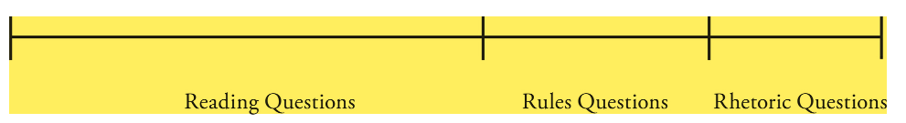
Reading and Writing Test

Slide 19
Specific Reading Strategies
On the Digital SAT, you have to read actively - to find specific information to answer specific questions. Once you’ve found the information, you need to understand what it’s actually saying. selecting the best vocabulary word to fill in a blank, understanding the function of a portion of the text, comparing multiple texts, finding the main idea of a text, determining which answer would best support the author’s argument, and completing the text based on data from tables and graphs.
Immediately look for:
Question Type: Know your strengths and not all show up in a single module so excluded types are likely to appear in second module
Literature: Fictional passages and Poems
Topic: Science, History, The Arts, etc.
Open Book Test!

Slide 20
Question Types
1) Vocabulary
VOCABULARY will be first group of questions. Tests a blend of common words with multiple meanings and slightly more advanced vocabulary words on harder questions. The context of the sentence(s) surrounding the word will provide a clue that you can Highlight/Annotate or Write down your own word that goes in the blank.
Format 1 – Given a Blank
Do NOT look at the answer choices.
Read the question
Understand what type of word should go where your blank is
Read the text and highlight THE CLUES.
Come up with your own word and either Annotate the blank or Write Down
Eliminate Answers that do not match yours
Guess
Format 2 - will ask what a word or phrase in the text “most nearly mean(s).”
Do NOT look at the answer choices.
Read the question understand what type of word should go where your blank is
Read the text and mentally cross off the word or phrase asked about highlight THE CLUES.
Come up with your own word and either Annotate the blank or Write Down
Eliminate Answers that do not match yours
Guess

Slide 21
The Chilean volcano Calabozos is located in __________ area. Therefore, the risk of loss of human life in the event of an eruption is minimal. Which choice completes the text with the most logical and precise word or phrase?

Slide 22
The Chilean volcano Calabozos is located in __________ area. Therefore, the risk of loss of human life in the event of an eruption is minimal. Which choice completes the text with the most logical and precise word or phrase?
A a hazardous
B an active
C a mountainous
D a remote

Slide 23
Best answer?
It is D- remote!

Slide 24
Contemporaries of American modernist poet H.D. focused only on her important contributions to the Imagist movement in the 1920s, taking __________ view of her work. However, she wrote in a variety of forms and genres, from short, lyrical works to complex, book length poems. Which choice completes the text with the most logical and precise word or phrase?

Slide 25
Contemporaries of American modernist poet H.D. focused only on her important contributions to the Imagist movement in the 1920s, taking __________ view of her work. However, she wrote in a variety of forms and genres, from short, lyrical works to complex, book length poems. Which choice completes the text with the most logical and precise word or phrase?
A an expansive
B a limited
C an imaginative
D a complicated

Slide 26
Best answer?
It is B- limited!

Slide 27
2) PURPOSE (WHY and HOW) will ask you why the author wrote the text or how a sentence functions in the text. Purpose questions are looking for the most likely, best supported reason that the text or sentence was written or included.
1). Do NOT look at the answer choices.
Read the question
Identify the question type. If you see the words purpose, function, or structure in the question stem, you have a Purpose question.
Read the text with focus on the role of the text within the paragraph. most authors will seek to inform, persuade, or argue
Highlight and Annotate
Main Purpose = find words central to author’s main claim
Function = ideas in previous sentence and next sentence for a connection
Overall Structure = Main Claim + How Claim is supported
Look in particular to highlight words that show some type of chronology, comparison, or contrast between ideas.
Avoid Recycled or Verbatim wording, content description and not content, opposite of purpose

Slide 28
Since the 1950s, scientists have known that rapid eye movement, or REM, occurs when someone is sleeping. Previous studies attempting to determine the meaning of these eye movements have been unsuccessful in part because these studies relied on human subjects recalling the content of their dreams. A recent study by physiologists Yuta Senzai and Massimo Scanziani has avoided this issue by studying dreaming mice instead. Their results suggest that REM is correlated to changes in direction during the dream.
Which choice best describes the function of the second sentence in the overall structure of the text?

Slide 29
Since the 1950s, scientists have known that rapid eye movement, or REM, occurs when someone is sleeping. Previous studies attempting to determine the meaning of these eye movements have been unsuccessful in part because these studies relied on human subjects recalling the content of their dreams. A recent study by physiologists Yuta Senzai and Massimo Scanziani has avoided this issue by studying dreaming mice instead. Their results suggest that REM is correlated to changes in direction during the dream. Which choice best describes the function of the second sentence in the overall structure of the text?
A It names a problem in the approach taken by Senzai and Scanziani.
B It introduces the difficulty that the study by Senzai and Scanziani was designed to bypass.
C It presents the findings of studies done prior to the study by Senzai and Scanziani.
D It clarifies how others studying REM sleep interpret the study by Senzai and Scanziani.

Slide 30
Best answer?
It is B

Slide 31
Read and Understand the Question. The presence of two texts will make it clear that this is a Dual Texts question, but it’s still critical to make sure exactly who or what you should be focusing on in each text.
Read Text 1 and highlight the idea or viewpoint referenced in the question. For text 1 highlight the specific hypothesis, statement, or claim that was0 referenced by the question.
Read Text 2 and highlight the main idea or viewpoint towards the same information from Text 1. Text 2 will typically feature an individual or group conducting an experiment or responding to the claim from Text 1 in some way. They could confirm the claim from Text 1, contradict it, or expand on it. Finding and highlighting the line or sentence in which Text 2 comments on the same idea that you highlighted from Text 1 is critical to understanding the connection between the texts.
Write the relationship (agreement, disagreement, or explanation) between the texts down in your Annotation box.
Use POE and eliminate answers that are inconsistent with one or both texts. The most common trap answers on Dual Texts questions are Opposites (answers that take the opposite viewpoint that Text 2 expresses, such as agreeing with Text 1 when Text 2 actually disagrees) and Extreme Language (answers that take a stated opinion or claim further than the relevant text can support).
DUAL TEXTS will offer you two texts rather than one and ask how someone from the second text would respond to an idea, person, or group from the first text. You are looking for is a single idea mentioned in the first text that is commented upon by the second.

Slide 32
Text 1 An animal is said to have a theory of mind when it is able to act according to the mental states of other individuals. Psychologists David Premack and Guy Woodruff studied whether chimpanzees have such a theory of mind. They showed videos of human actors struggling with various problems. The chimpanzees were able to select photographs that showed the best tool to solve each actor’s problem.
Text 2 Biologist Daniel J. Povinelli and psychologists Kurt E. Nelson and Sarah T. Boysen have argued that previous research into whether chimpanzees have a theory of mind have not adequately addressed alternative explanations for the chimpanzees’ behaviors. Specifically, it may be the case that chimpanzees are following learned behaviors in a known environment, rather than applying a theory of mind in a novel situation. Based on the texts, how would Povinelli, Nelson, and Boysen (Text 2) most likely respond to Premack and Woodruff (Text 1)?
TURN & TALK- try to answer this on your own ☺

Slide 33
CONCLUSIONS question will ask you to complete the text by asking you which of the four answers is a logical conclusion based on all of the other sentences given in the text. You just need to read for the main claim made or investigated by the author and choose a conclusion that is logically consistent with both the claim and anything the author includes or discovers in relation to the claim.
Read the Question.
Identify the Question Type. If a question says Which choice most logically completes the text, you know that you have a Conclusions question. Almost every Conclusions question is phrased this way, though we have also seen “Which choice best describes X as presented by the text?” Either way, you’re being asked to include a logical summary or final statement consistent with everything described in the text.
Read the Text. Here, the central claim or statement made by the author or group is likely to be followed up by some additional data or information. This information could support or contradict the original claim, but either way, you’ll need to read the entire text to make sure you catch those wrinkles in the story!
Highlight What Can Help. There are two helpful things to highlight on Conclusions questions: the claim itself and, as mentioned, the additional data or information that sheds more light, for better or worse, on the claim. Similarly, if the question instead asks you to describe someone or something, you’ll want to catch each major point made about that person or thing, as the correct answer should be a summary that captures all of the main points made by the text.
Use POE. The most common trap answer on Conclusions questions is Recycled Language, as College Board is counting on you to only look for matching words but not matching ideas. You’ll also see Right Answer, Wrong Question, as wrong answers can focus on a single detail from the text rather than serve as a conclusion to the entire text. Lastly, you’ll see Could Be True trap answers, as logical or real-world conclusions that are not supported by the text can really seem justified unless you double down on your highlighting and remember that you are here to eliminate answers, not justify them!

Slide 34
Now, the choices that college board gave you:
A They would argue that nonhuman primates other than chimpanzees, such as baboons and gorillas, may also have a theory of mind.
B They would argue that the chimpanzees would be able to solve the problems themselves without referencing the photographs by struggling with the situation themselves and eventually determining the correct solution.
C They would encourage Premack and Woodruff to show the same videos and photographs to other nonhuman primates and compare the other nonhuman primates’ reactions to the chimpanzees’ reactions.
D They would suggest that placing the chimpanzee subjects in novel environments, such as rooms distinct from the chimpanzees’ regular enclosures, may help better ascertain whether chimpanzees have a theory of mind

Slide 35
What do you think?....
D

Slide 36
Math Test
-Look for ways to eliminate answer choices that are too big or too small.
- Ballparking can help you find the right answer without extensive calculations, avoid trap answers, and improve your chances of getting the question right even if you have to guess.
-Use the built-in tools as much as possible. The most useful ones on the Math section are the Calculator, Reference Sheet, and Answer Eliminator tool.
-Use your scratch paper constantly: number the work for each question, write down key words from the final question, redraw geometric figures, and write down every step of math. Even if you use a calculator, it’s worth setting up the math on your scratch paper to stay organized and avoid mistakes.
Utilize the Word Problem Basic Approach: Read the Final Question (RTFQ), Let the Answers Point the Way, Work in Bite-Sized Pieces, and use Process of Elimination (POE).
Practice with the calculator you plan to use for the test: either the built-in Desmos calculator or your personal scientific or graphing calculator.
If you are going to use the built-in calculator, read the Digital SAT Calculator Guide in your Student Tools to maximize its effectiveness.
If you are going to use your own calculator, make sure it is on the approved list and has fresh batteries.
Set up the question on the scratch paper before entering anything into a calculator. By doing so, you will eliminate the possibility of getting lost or confused.
A calculator can’t help you find the answer to a question you don’t understand. Be sure to use your calculator as a tool, not a crutch.
Whether you are using a calculator or not, you must always perform calculations in the proper order (PEMDAS).

Slide 37
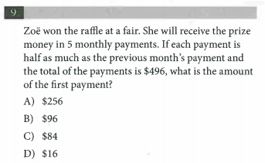
Math Techniques –
Plugging In The Answers (PITA):
Powerful technique used to work through a problem backwards. Use their answer choices against them!

Slide 38

This is exactly what we will NOT do! No Algebra!

Slide 39
Start by plugging in either B or C because of their central location. This will provide guidance…do you need a higher or lower number?
Let’s begin with answer choice B
96, then 48, 24, 12, 6…not enough! Cross off B, C, D!
Answer must be A! Write answer next to question #

Slide 40
Math Techniques –
Plugging In Your Own Numbers:
Powerful technique used when the answer choices are NOT numbers. It is done in three key steps:
1) Pick a “nice” number for the variable in the problem
2) Work through the steps of the problem using your number. This will give you a “target” to shoot for.
3) Put the number you chose originally into the answer choices and see which one produces your “target”

Slide 41
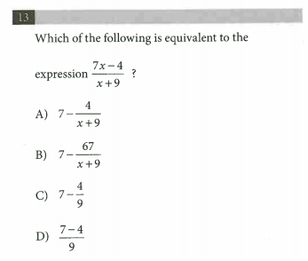
Students can VERY easily get swallowed up by the Algebra here...reduce the difficulty by Plugging In a nice number. Let’s choose 2 for x…

Slide 42

On rare occasions, two answer choices will work, so make sure you check them all

Slide 43
This is exactly what we will NOT do! No Algebra!

Slide 44
Start by plugging in either B or C because of their central location. This will provide guidance…do you need a higher or lower number?
Let’s begin with answer choice B
96, then 48, 24, 12, 6…not enough! Cross off B, C, D!
Answer must be A! Write answer next to question #

Slide 45
Questions?

