Slide 1
Cracking the SAT
New England Educational opportunity conference 2018
April 5, 2018
Bill Goldsworthy
Lyndon state college
Upward bound
wxg10070@vsc.edu
goldsworthyw@hartfordschools.net

Slide 2
2017 National
2017 National Low Income
2017 Vermont
2017 Upward Bound (19 seniors)
Total=1163 M=587 ERW=576

Slide 3
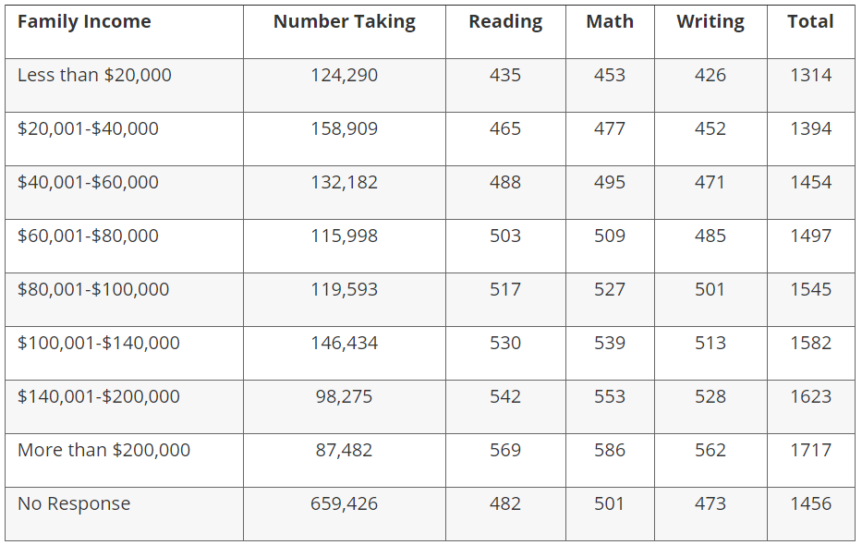
2016 Results
Total
888
942
983
1012
1044
1069
1095
1155
983
2016 Results
UB
R=558
M=572
Total=1130

Slide 4
Test Structure:
MATH TEST (65 questions in 70 minutes)
No calculator: Section 3; 25 minutes, 20 questions
Calculator: Section 4; 55 minutes, 38 questions
Grid-Ins: 13 of the total questions
EVIDENCED-BASED READING AND WRITING TEST
READING (52 questions in 65 minutes)
5 passages and a variety of PASSAGE-BASED multiple choice questions
WRITING (44 questions in 35 minutes)
Passage based proof reading and editing.

Slide 5
General Techniques:
Learn to think like the test writers – CB has written tests for over 80 years! They know exactly how students approach the questions.
The SAT is NOT school! For example, maximize arithmetic and minimize Algebra.
Look for wrong answers first...after all, there are more of them!
Process of Elimination (POE) – With practice, students can eliminate at least one answer choice on every problem.

Slide 6
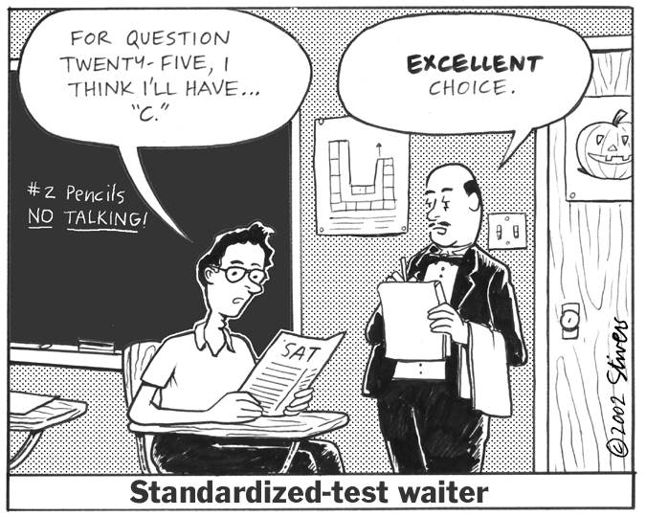
General Techniques:
Letter of the Day – When you can’t eliminate an answer choice, you run out of time for questions, or you have no idea how to start a question, bubble in a pre-selected A – D letter. (Last Resort)

Slide 7
Why it is important to know the test writers:
What percentage of U.S. communities rely on surface freight transportation for goods and materials?
(A) 10% (B) 25% (C) 50% (D) 67%
How many miles has truck driver N.F. Plunkett driven without an accident?
(A) 800,000 (B) 1,000,000 (C) 1,500,000 (D) 2,500,000
What is the average time to transport Florida oranges to a midwest grocery store?
(A) 4 days (B) 35 hours (C) 75 hours (D) 3 days

Slide 8
Math Sections:

Slide 9
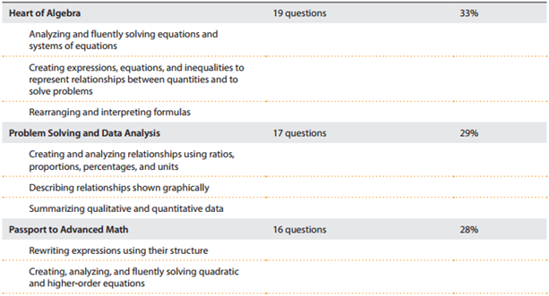

Slide 10
Math Section Scoring:
Overall Section Score: 200 – 800
Three Sub-Scores : 1 – 15 score for:
The Heart of Algebra
Problem Solving & Data Analysis
Passport to Advanced Math
*Additional Topics is not given a Sub-Score
* No more scoring penalty…now Rights-Only scoring!

Slide 11
Attacking the SAT Math Sections:
Employ the Two Pass System – Answer everything you can do efficiently first to bank time for the 2nd pass.
Slow down, score higher! Accuracy versus Speed – Students tend to rush and try to answer every question on their first SAT.
Pacing – Personal Order of Difficulty (POOD)

Slide 12
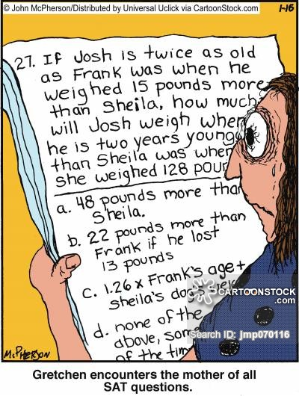
Math Strategies:
Before any math happens, we must read carefully!
Mark up the questions – Underline key words, phrases and values.
Analyze questions in Bite-Sized Pieces
Do as little math as possible! (Arithmetic vs. Algebra)

Slide 13
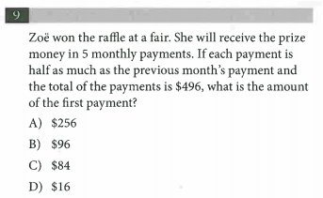
Math Techniques –
Plugging In The Answers (PITA):
Powerful technique used to work through a problem backwards. Use their answer choices against them!

Slide 14
This is exactly what we will NOT do! No Algebra!

Slide 15
Start by plugging in either B or C because of their central location. This will provide guidance…do you need a higher or lower number?
Let’s begin with answer choice B
96, then 48, 24, 12, 6…not enough! Cross off B, C, D!
Answer must be A! Write answer next to question #

Slide 16
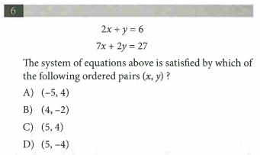
You Try:
ETS wants you to use the algebraic techniques of Substitution & Elimination, but we will simply plug in the coordinates!

Slide 17
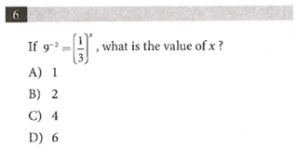
Students can get bogged down in creating equivalent expressions…save time and PITA!

Slide 18
Math Techniques –
Plugging In Your Own Numbers:
Powerful technique used when the answer choices are NOT numbers. It is done in three key steps:
1) Pick a “nice” number for the variable in the problem
2) Work through the steps of the problem using your number. This will give you a “target” to shoot for.
3) Put the number you chose originally into the answer choices and see which one produces your “target”

Slide 19
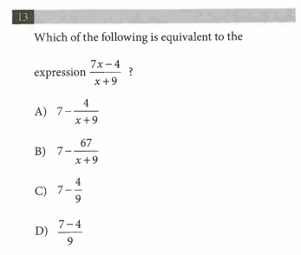
Students can VERY easily get swallowed up by the Algebra here...reduce the difficulty by Plugging In a nice number. Let’s choose 2 for x…

Slide 20
On rare occasions, two answer choices will work, so make sure you check them all

Slide 21
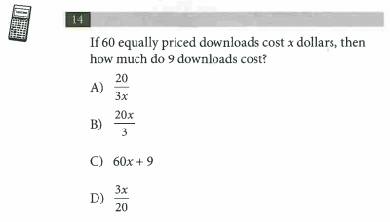
Are there numbers we should avoid choosing?
Yes! Avoid choosing 0 and 1…mathematically, zero destroys terms and one doesn’t change the terms.
Notice here that Plugging In one would cause answer choices A and B to be the same…

Slide 22
Evidence-based Reading and Writing Section Scoring:
Overall Section Score: 200 – 800
Combination of
Reading scaled score of 10-40
Writing scaled score of 10-40

Slide 23
Reading Section:

Slide 24
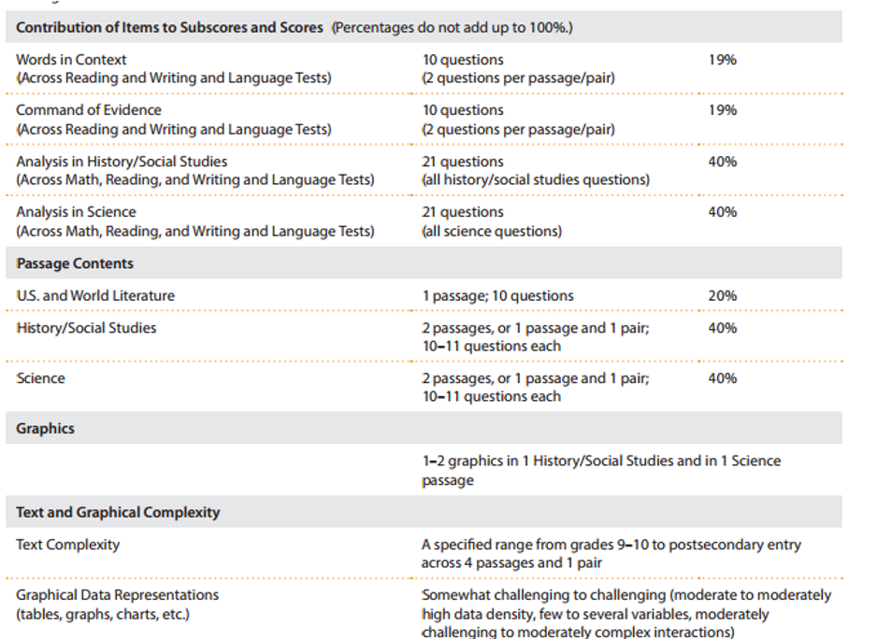

Slide 25
Attacking the SAT Reading Section:
Open Book Test – NO GENERAL READING!
Support all answers with information from the passage. If not in passage, can’t be answer.
Use POE and be aggressive, odds are in your favor.
The answer must be there so find it!
DO NOT answer ALL
Consider
Type of passage
Topic of passage
Type of questions

Slide 26
Attacking the SAT Reading Section:
Question types
Inference: Never infer, but stick to the facts. Must be able to prove correct answer.
Vocabulary in context: Cross out the word and then turn into a sentence completion problem.
Main Idea/General: Use your knowledge gained doing specific questions first
Charts and Graphs: Straight forward and no computations
Dual passage: Do one at a time and find specific support in EACH

Slide 27
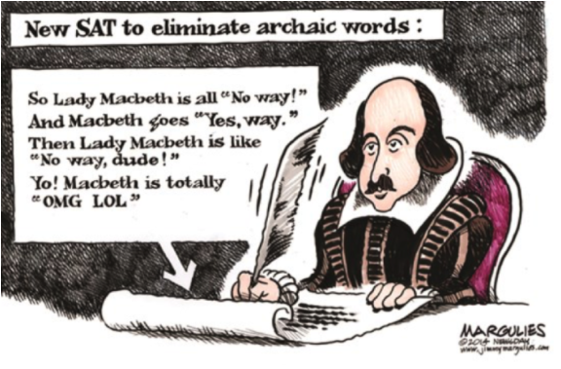
Reading Strategies:
Read Blurb
Do vocab-in-context
Attack short and easily understood questions
Put question into own words.
Read 5 lines before and after line reference or lead word searching for the answer.
Give an answer from what you read.
Choose answer choice closest to yours.

Slide 28
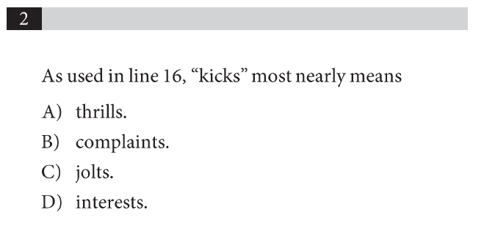
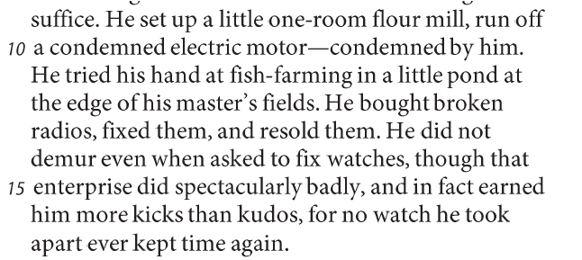
You try:

Slide 29
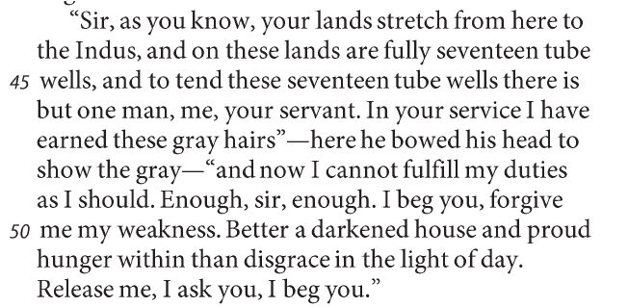
You try:

Slide 30
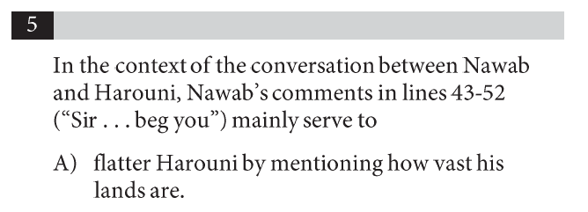
You try:

Slide 31
Writing Section:

Slide 32
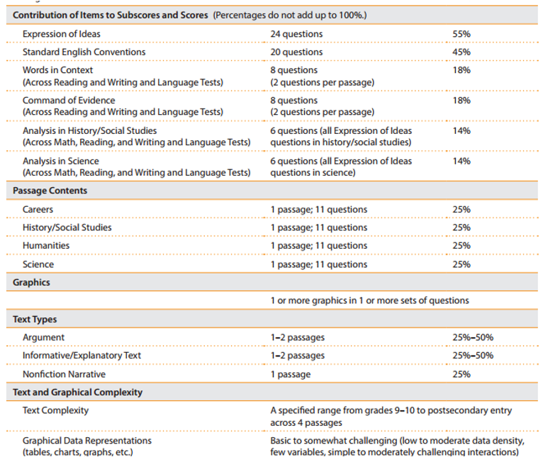

Slide 33
Attacking the SAT Writing Section:
The answer choices ask the questions
Identify what is changing in the answers – this is what they are testing
The way we speak is often different from the way we write
Process Of Elimination does most of the work
If you eliminate B, C, and D then there is nothing wrong with the writing
If you haven’t eliminated 3 answer choices, choose the shortest answer that is most consistent with the rest of the sentence.

Slide 34
Attacking the SAT Writing Section:
Punctuation
Know what is a STOP, HALF-STOP, GO
Vertical line test
Commas
Apostrophes
Words
Testing mainly verbs, nouns, and pronouns
CONSISTENCY: Correct answers are consistent with the rest of the sentence and the passage.
If verbs are changing, make sure they are consistent with their subjects and with other verbs in the sentence and surrounding sentences
If nouns are changing, make sure those nouns are consistent with the other nouns in the sentence and surrounding sentences
PRECISION: Correct answers are as precise as possible.
CONCISION: Barring other errors, correct answers are as concise as possible.

Slide 35
And what about the Essay:
?

Slide 36
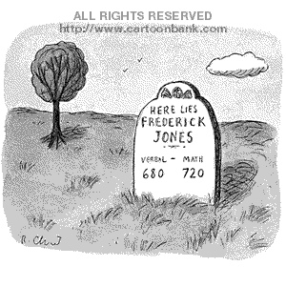
Thank you! Any questions?
Bill Goldsworthy
wxg10070@vsc.edu
goldsworthyw@hartfordschools.net

