Slide 1
Refund Request Tutorial

Slide 2
Direct Deposit Refund
Log into Webcat
Under the Billing tab, select Request refund

Slide 3
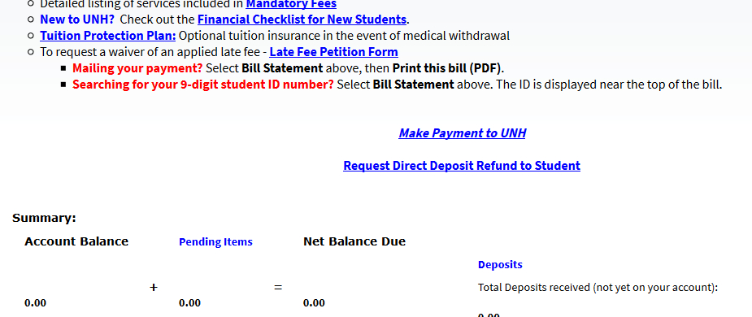
Direct Deposit Refund
Select “Request Direct Deposit Refund to Student” in the center of the screen

Slide 4
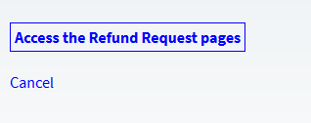
Direct Deposit Refund
Select “Access the Refund Request pages”
Set up/answer your security question

Slide 5
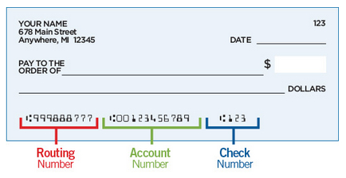
Direct Deposit Refund
Enter/update your banking information.
Be sure to double check the routing and account numbers. Incorrect account numbers can delay your refund. Note: Bank account numbers are NOT the number on your credit/debit card.

Slide 6
Direct Deposit Refund
Enter the amount you would like refunded
Press “Continue”

Slide 7
Direct Deposit Schedule
Refunds requested before Tuesday @ 7pm will be in your bank account by Friday
Refunds requested before Friday @ 7pm will be in your bank account by the following Wednesday

Slide 8
Some Common Errors
Credit on account must not be “pending”
Recent check or e-check payments must clear the bank before refunding (10-14 days)

Slide 9
Some Common Errors
VA payments must be screened by our office
Study Abroad students cannot request their own refunds
Please email business.services@unh.edu if you need assistance

